Slide 1
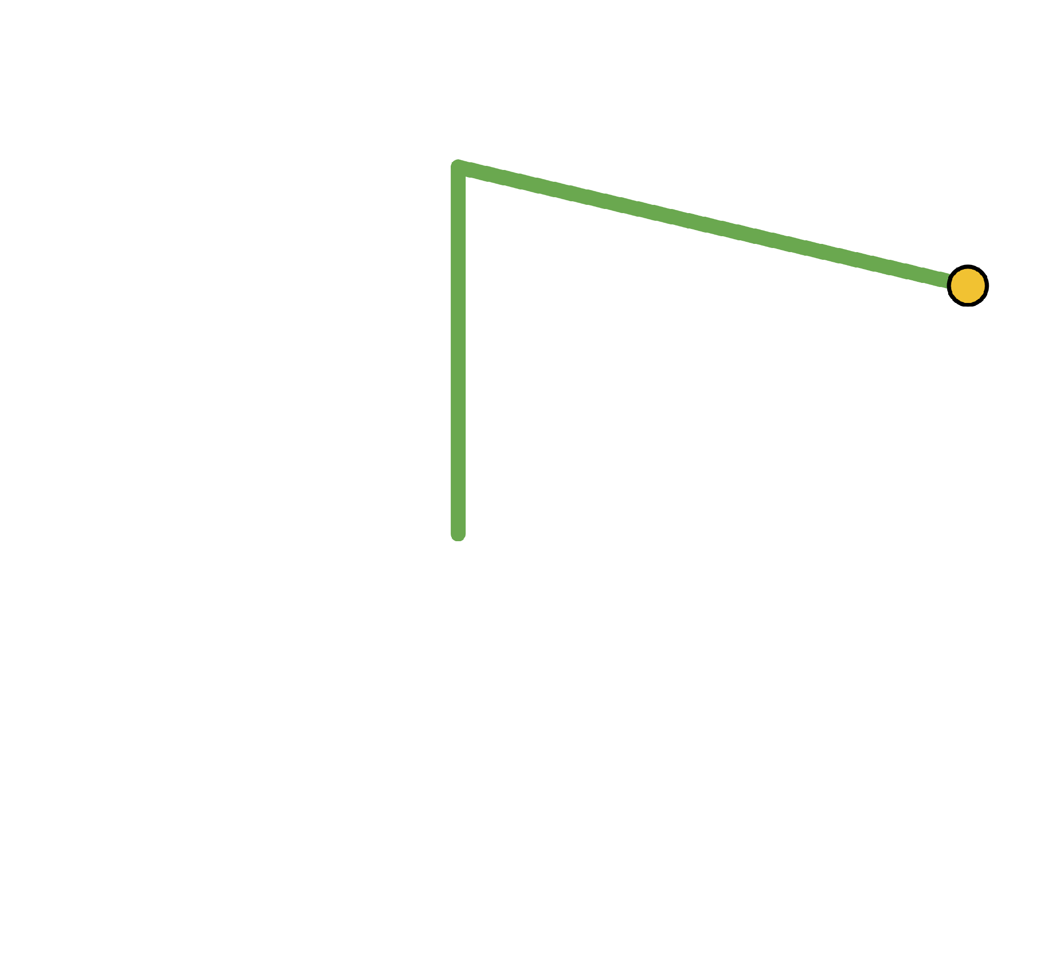
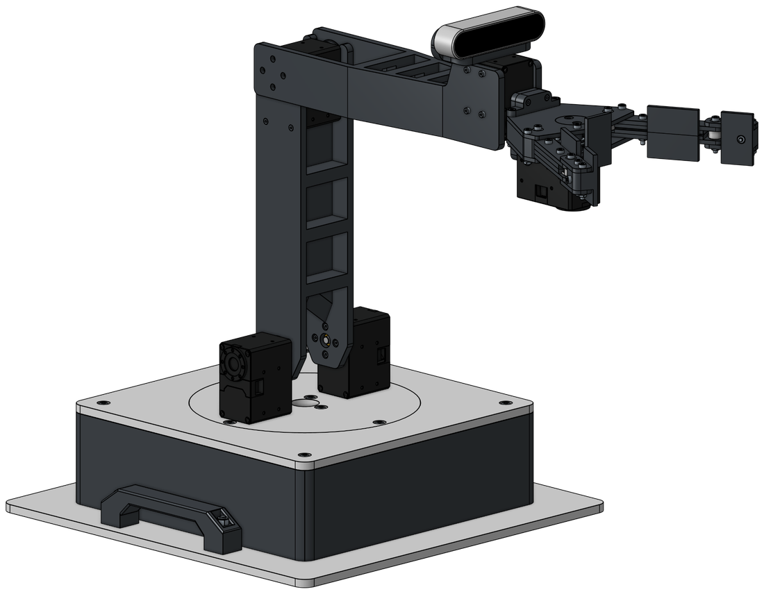
The Denavit-Hartenberg Approach to Forward Kinematics
ROBOTIC ARM COURSE · LESSON 4 OF 12
θE
3
(X, Y, Z)
2
θS
Turning joint angles into the end effector's position, one matrix per joint
1
θB
Day 1 · Rotation and movement matrices
Day 2 · Extending to 3D

Slide 2
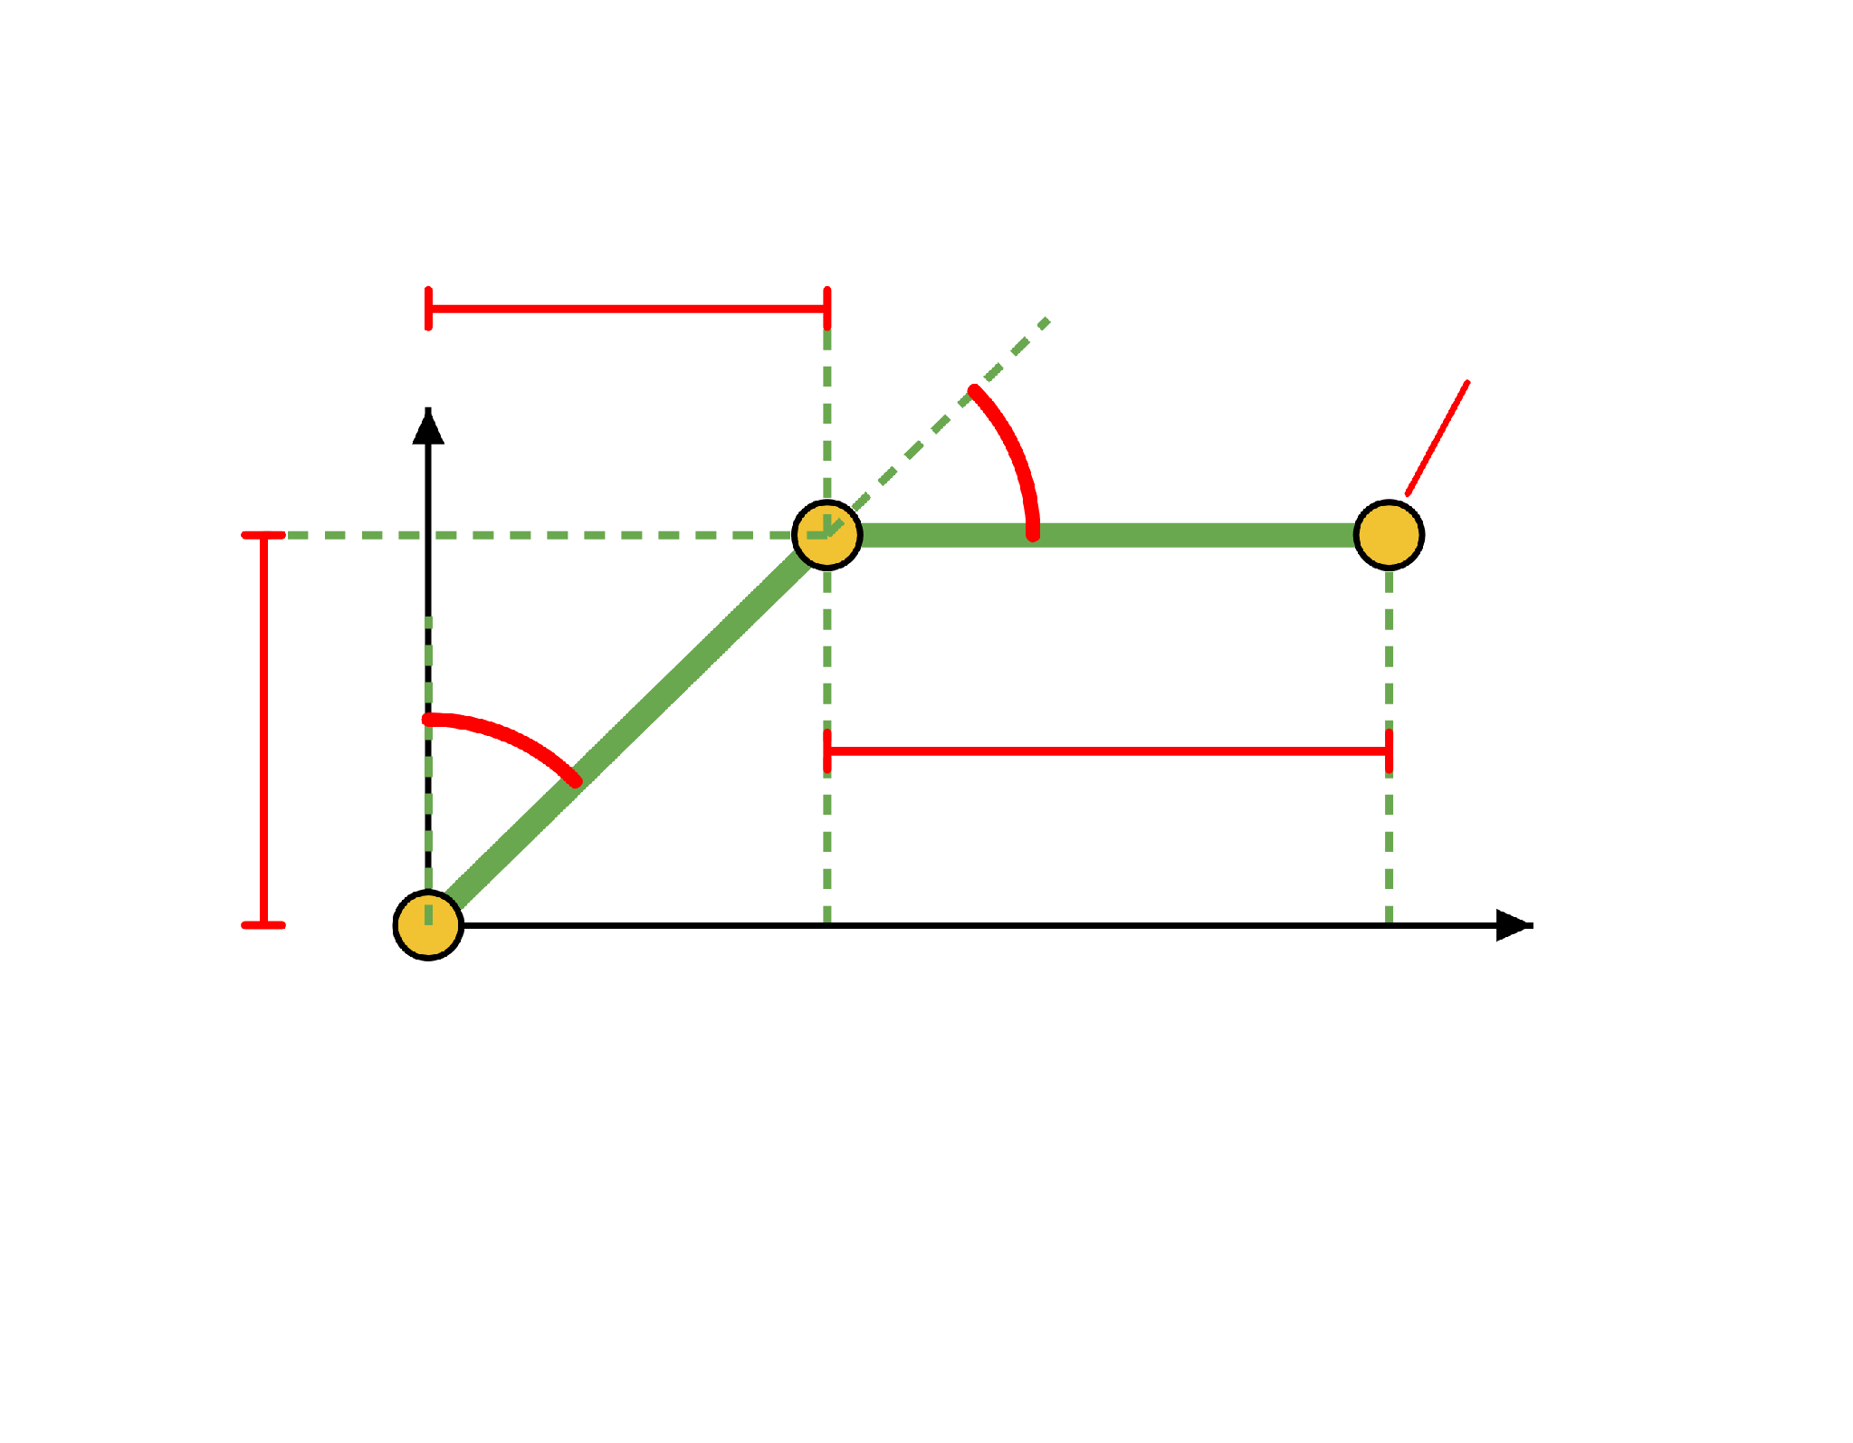
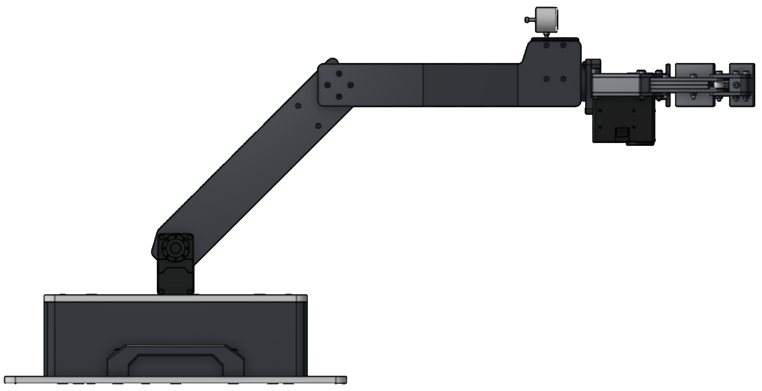
Where Lesson 3 Left Off
RECAP · LESSON 3
GIVEN
L₁ = L₂ = 250 mm
ΔX₁
θS = 45°, θE = 45°
(X, Y)
Y
θE
THE TRIANGLES GAVE
ΔX₁ = ΔY₁ = 176.78 mm
θS
ΔX₂ = 250 mm, ΔY₂ = 0 mm
ΔY₁
ΔX₂
(X, Y) = (426.78, 176.78)
X
(0, 0)
Lesson 3 called the angles θ₁ and θ₂. From
now on: θS for the shoulder, θE for the elbow
and θB for the base.

Slide 3
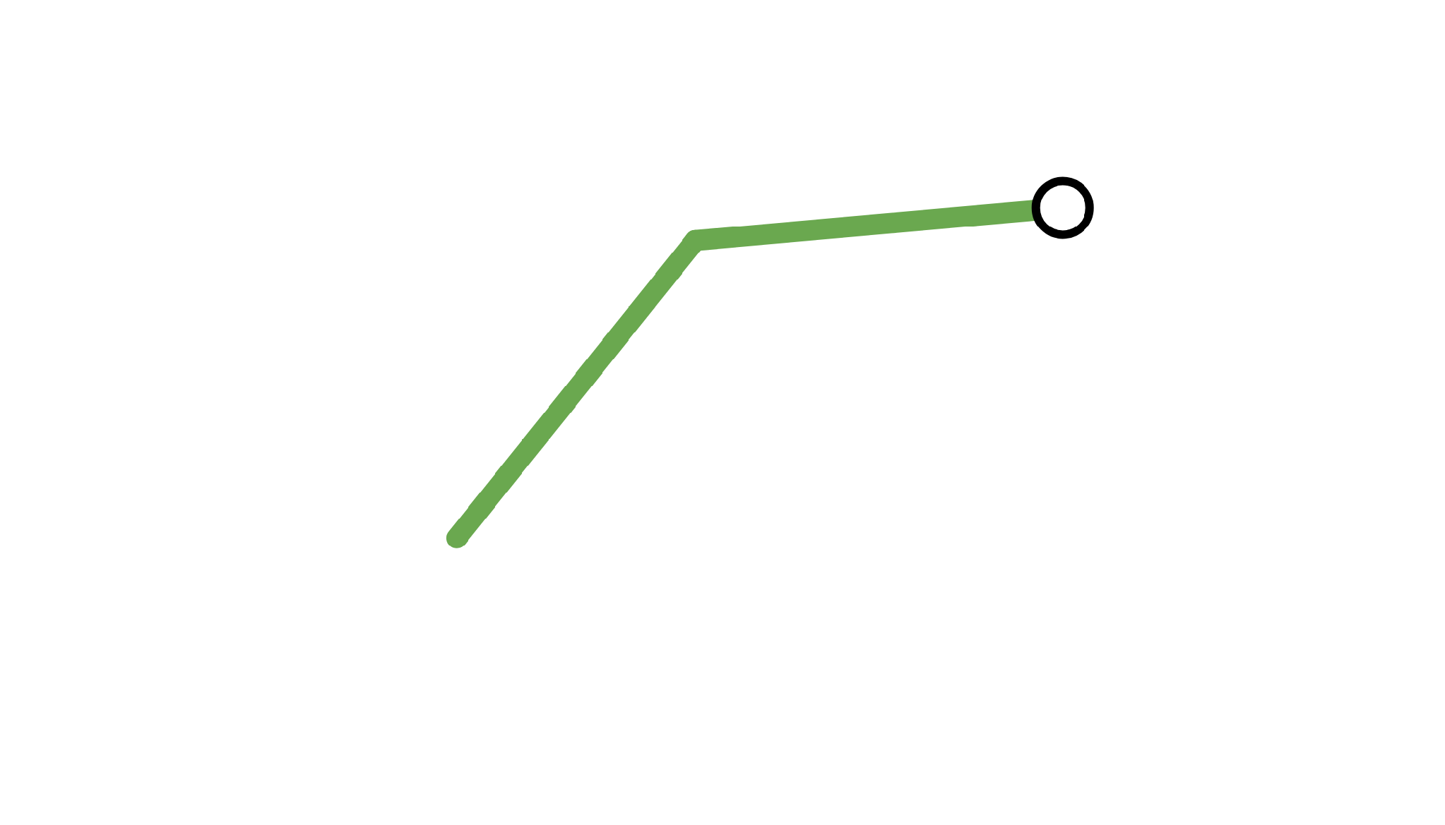
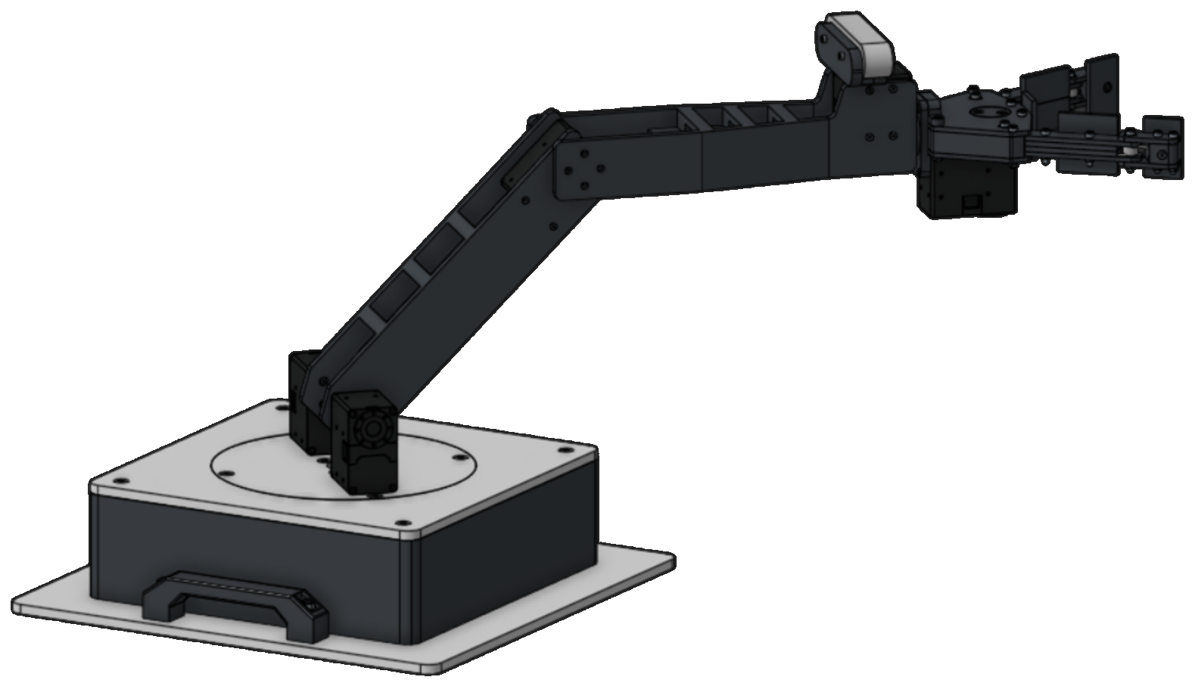
One Recipe for Every Joint
WHY MATRICES
3
T
Lesson 3 used triangles. Every new joint needed new triangles, and the turning base made the problem 3D.
2
1
1 · BASE
2 · SHOULDER
3 · ELBOW
RESULT
A₁
×
A₂
×
A₃
=
T
one matrix
one matrix
one matrix
gives the position
DAY 1
DAY 2
The flat (2D) arm, using rotation and move matrices
The real (3D) arm, using the Denavit-Hartenberg recipe

Slide 4
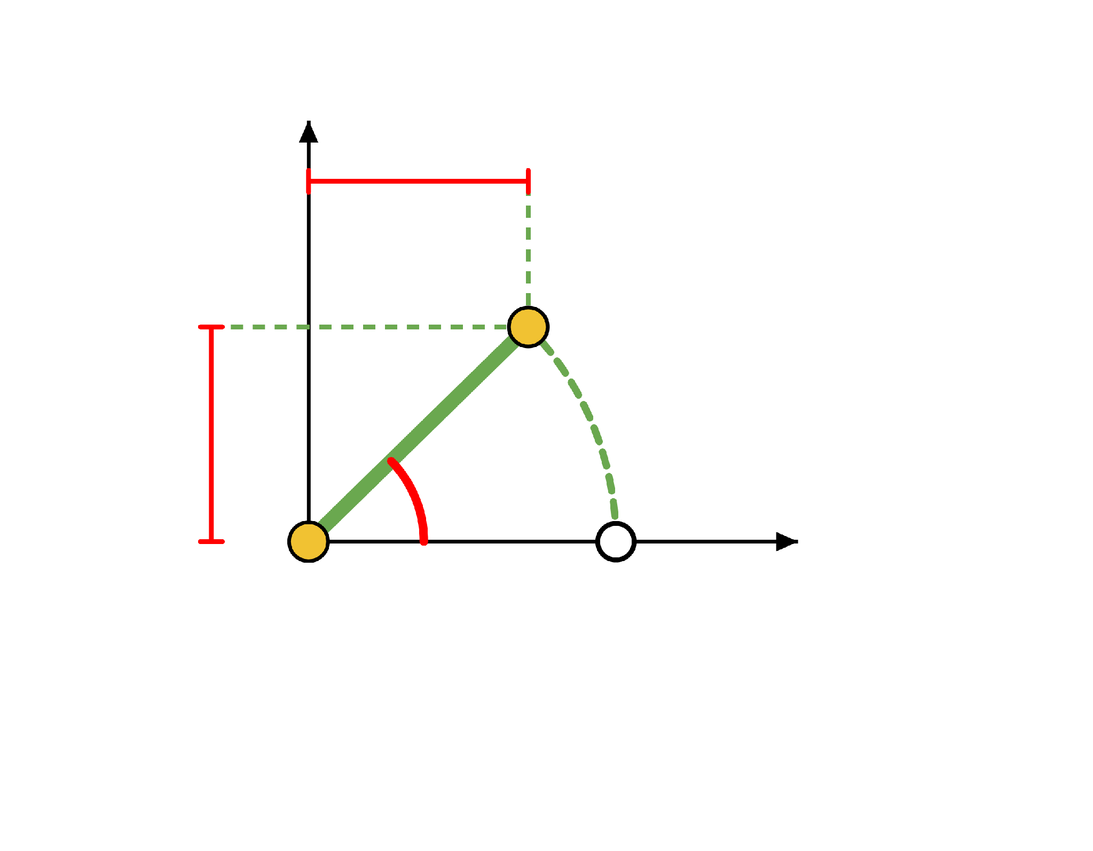
Rotating a Point
DAY 1 · ROTATION
Spin the point P = (250, 0) by 45° around the origin.
y
x′ = 176.78
Where does it land?
P′
x′ = 250 · cos 45° = 176.78
y′ = 250 · sin 45° = 176.78
y′ = 176.78
45°
P′ = (176.78, 176.78)
x
P = (250, 0)
Same numbers as ΔX₁ and ΔY₁ in Lesson 3. The first link is just a point that was rotated.

Slide 5
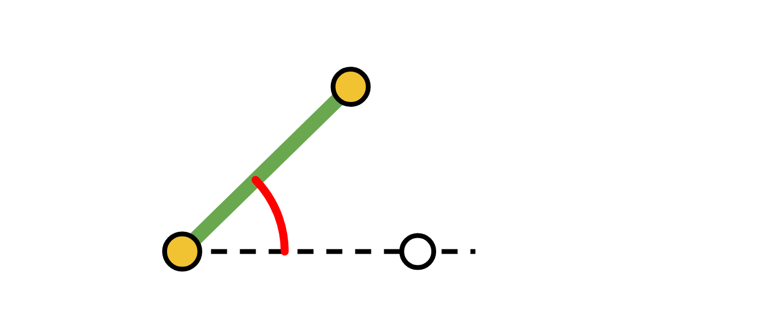
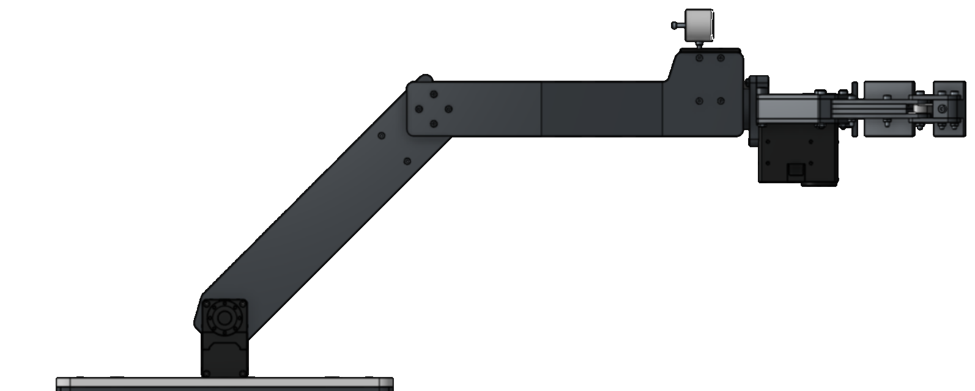
The Rotation Matrix
P′
DAY 1 · ROTATION
θ
P
The two formulas for rotating a point (x, y) by θ fit inside one matrix.
cos θ
−sin θ
x
x cos θ − y sin θ
×
=
sin θ
cos θ
y
x sin θ + y cos θ
rotation matrix R(θ)
the point P
the rotated point P′ = (x′, y′)
HOW TO MULTIPLY
WHAT R(θ) DOES
Take one row of the matrix. Multiply it entry by entry
with the point, then add. Row 1 gives x′. Row 2
gives y′.
It spins any point by θ, counter-clockwise, around
the origin.

Slide 6
Worked Example: Rotation
P′
DAY 1 · ROTATION
45°
P
Rotate P = (250, 0) by 45°. At 45°, cos and sin are both 0.7071.
0.7071
−0.7071
250
176.78
×
=
0.7071
0.7071
0
176.78
R(45°)
P
P′
ROW 1 GIVES x′
ROW 2 GIVES y′
0.7071 × 250 + (−0.7071) × 0 = 176.78
0.7071 × 250 + 0.7071 × 0 = 176.78
P′ = (176.78, 176.78), the same answer as the cos and sin formulas.

Slide 7
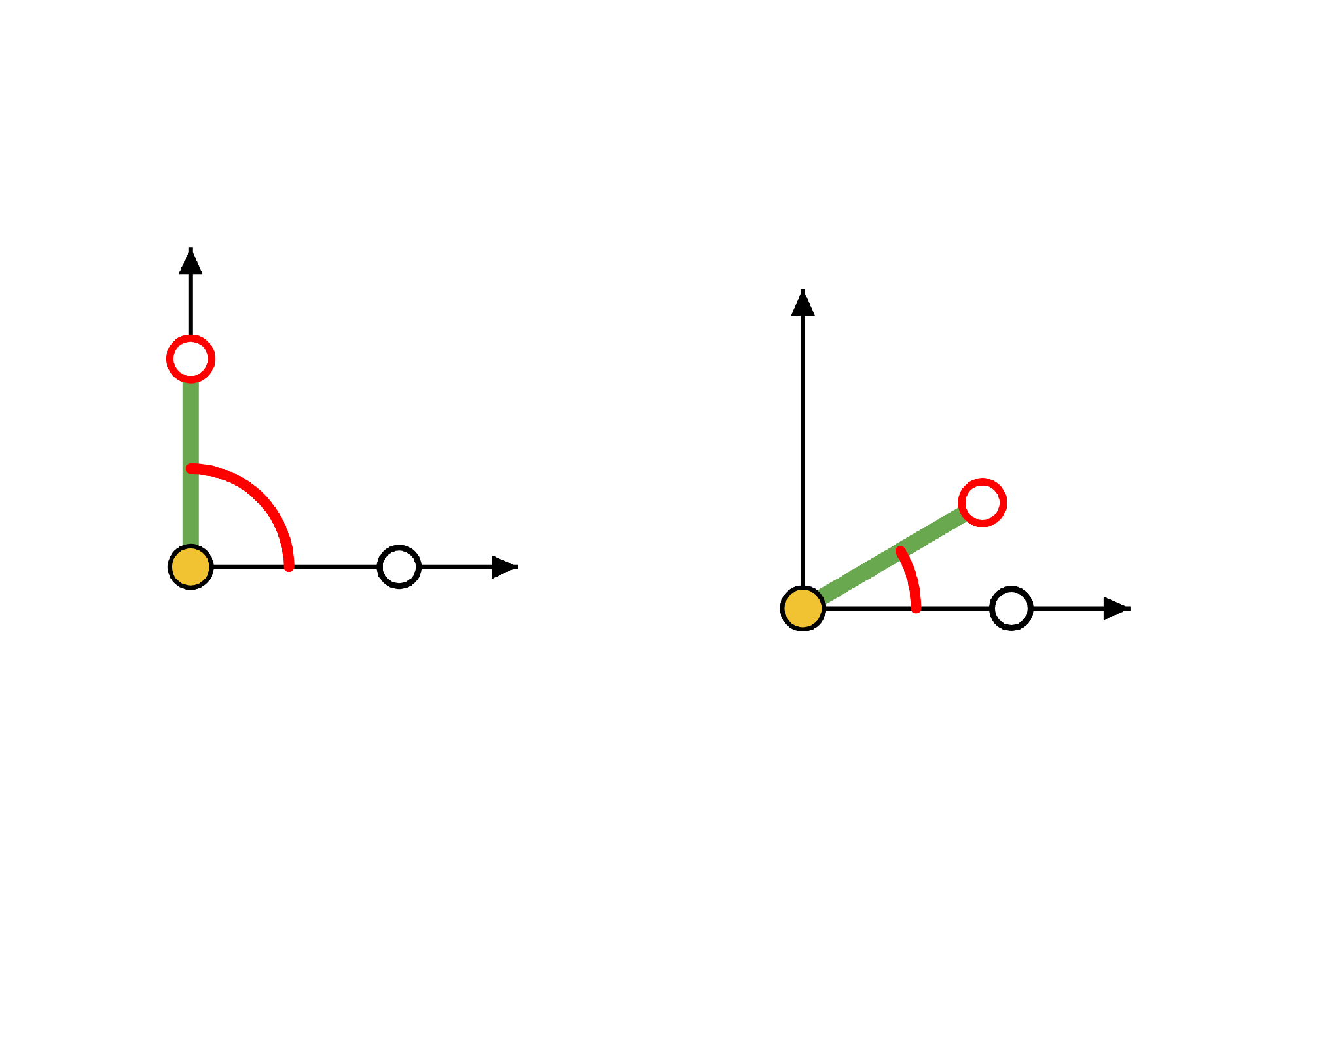
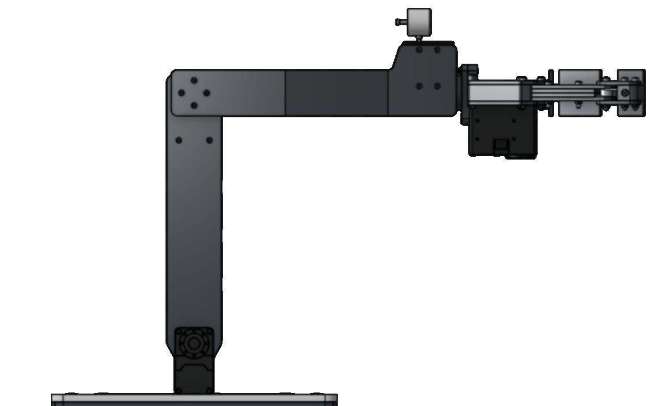
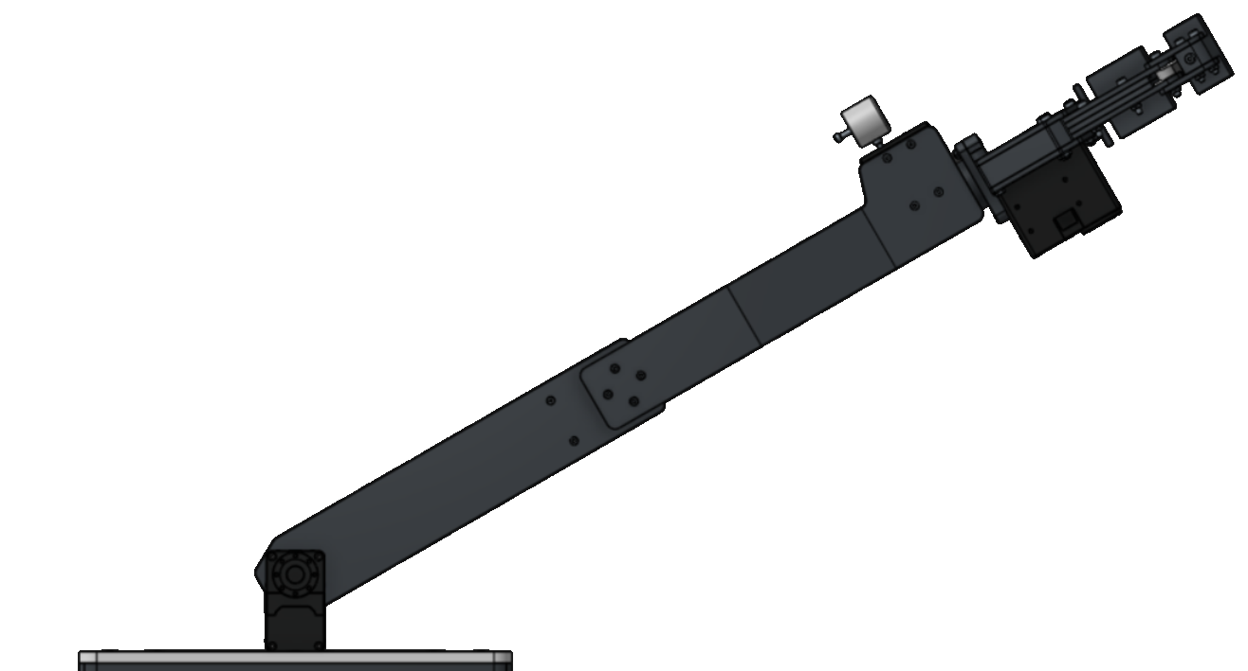
Try It Yourself #1
DAY 1 · TRY IT YOURSELF
Rotate P = (250, 0) by each angle. Find P′ = (x′, y′).
(a) θ = 90°
(b) θ = 30°
(a) θ = 90°
(b) θ = 30°
(?, ?)
(?, ?)
SOLUTION
(a) 90°: cos 90° = 0, sin 90° = 1
P′ = (0, 250)
P
P
(b) 30°: cos 30° = 0.8660, sin 30° = 0.5
P′ = (216.51, 125.00)

Slide 8

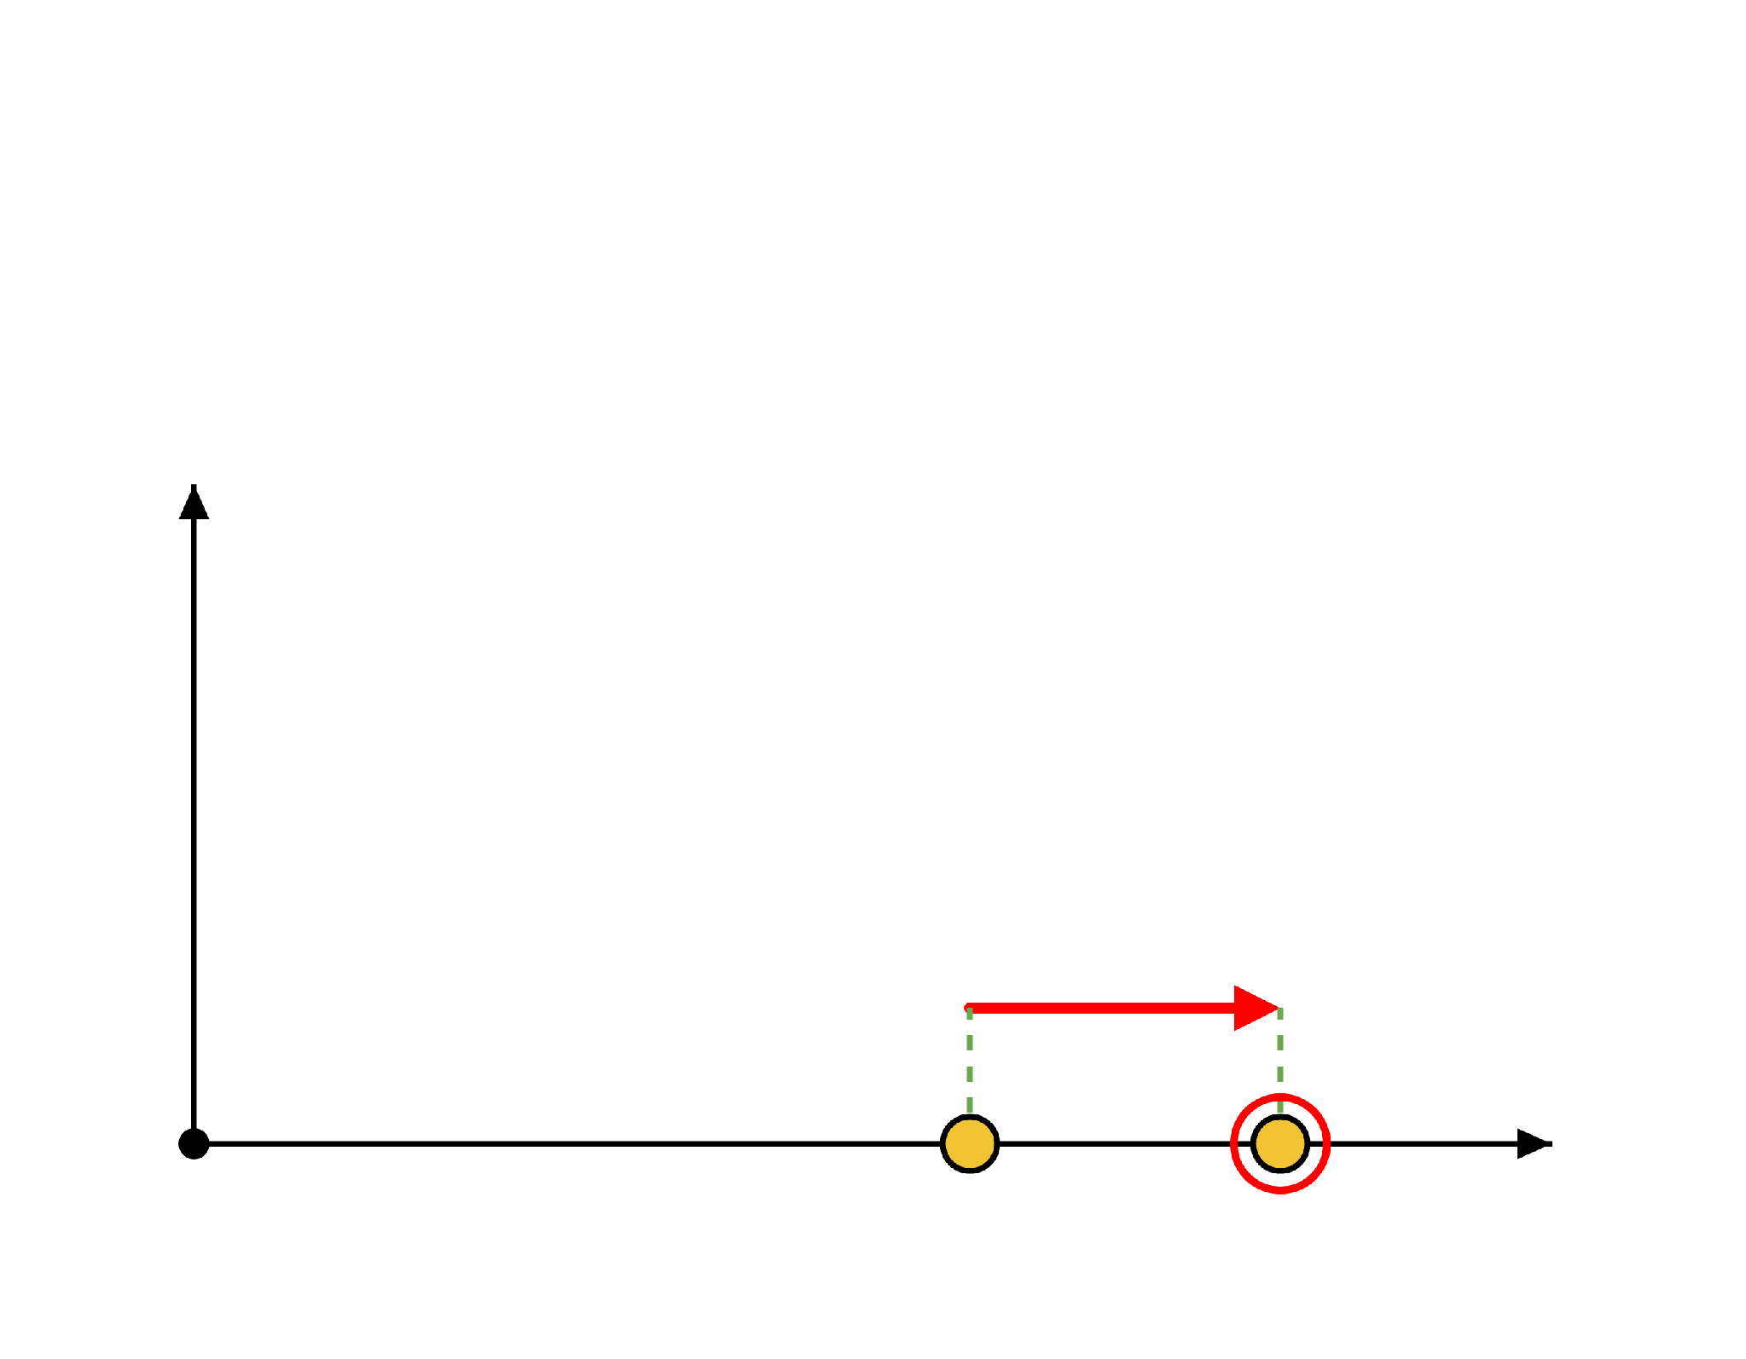
Moving a Point
T(250, 0)
DAY 1 · MOVING A POINT
Slide the point P = (250, 0) to the right by 100.
x′ = x + 100 = 350
y′ = y + 0 = 0
y
P′ = (350, 0)
THE PROBLEM
+100
Rotating is multiplying. Moving is adding. Our 2×2 matrix can only multiply, so it cannot move a point.
x
P = (250, 0)
P′ = (350, 0)

Slide 9
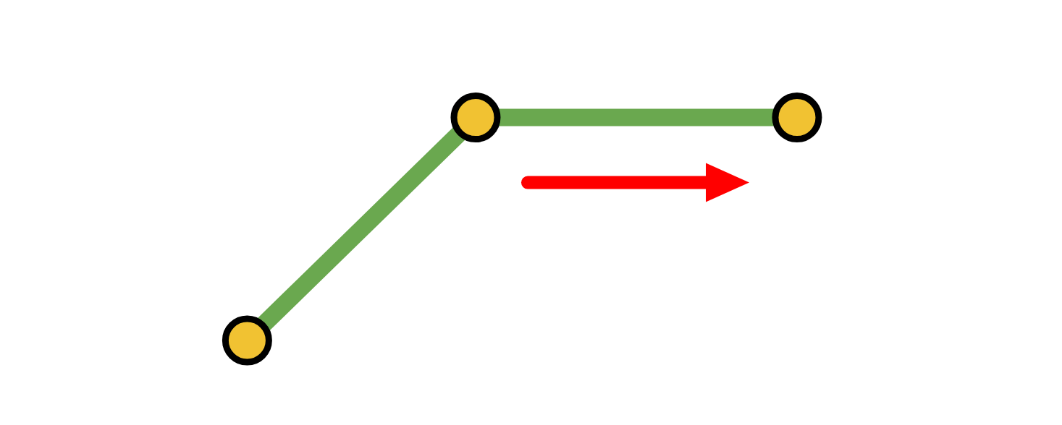
The Extra 1
DAY 1 · MOVING A POINT
T(250, 0)
Write every point with an extra 1: (x, y) becomes (x, y, 1). Now moving is a multiplication too, using a 3×3 matrix.
1
0
100
250
350
cos θ
−sin θ
0
R(θ)
sin θ
cos θ
0
0
1
0
×
0
=
0
0
0
1
spin by θ
0
0
1
1
1
T(100, 0)
P
P′
1
0
dx
T(dx, dy)
0
1
dy
0
0
1
move dx right, dy up
Row 1: 1 · 250 + 0 · 0 + 100 · 1 = 350. The extra 1 is what
picks up the 100.

Slide 10
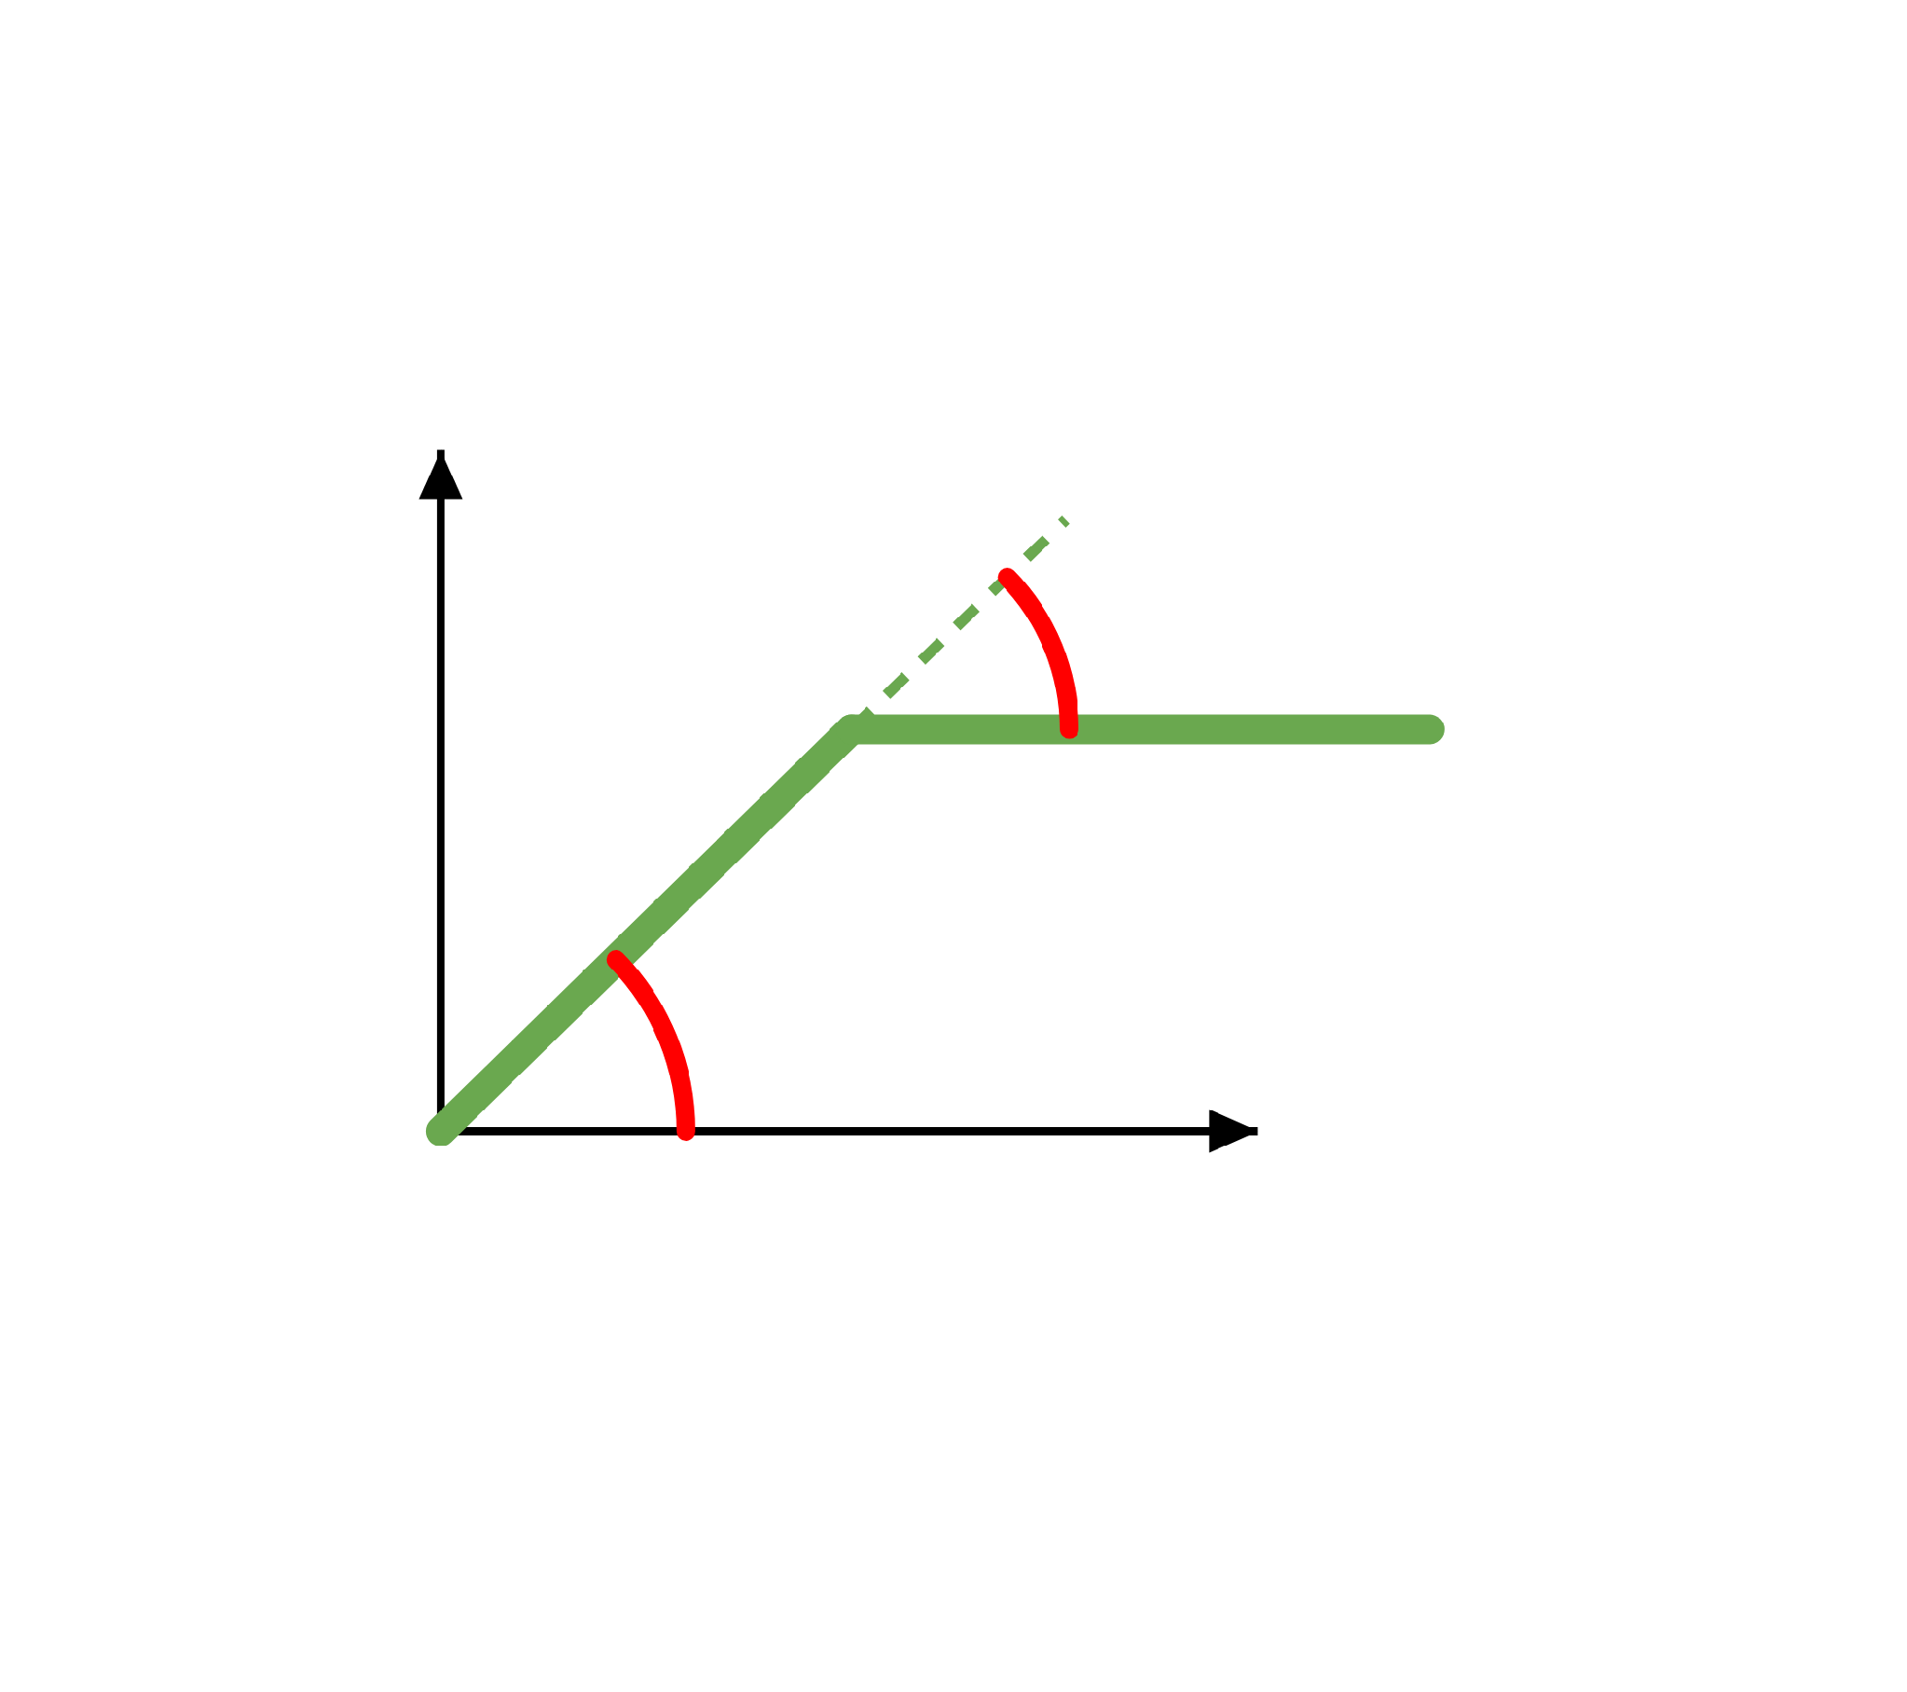
The Arm as a Chain of Matrices
DAY 1 · THE 2D ARM
1
Turn at the shoulder
R(θa)
2
Travel along the upper arm
T(250, 0)
y
θb
3
Turn at the elbow
R(θb)
3
4
T(250, 0)
2
4
Travel along the forearm
θa
1
x
M = R(θa) · T(250, 0) · R(θb) · T(250, 0)
Read left to right, it is the story of the arm.

Slide 11
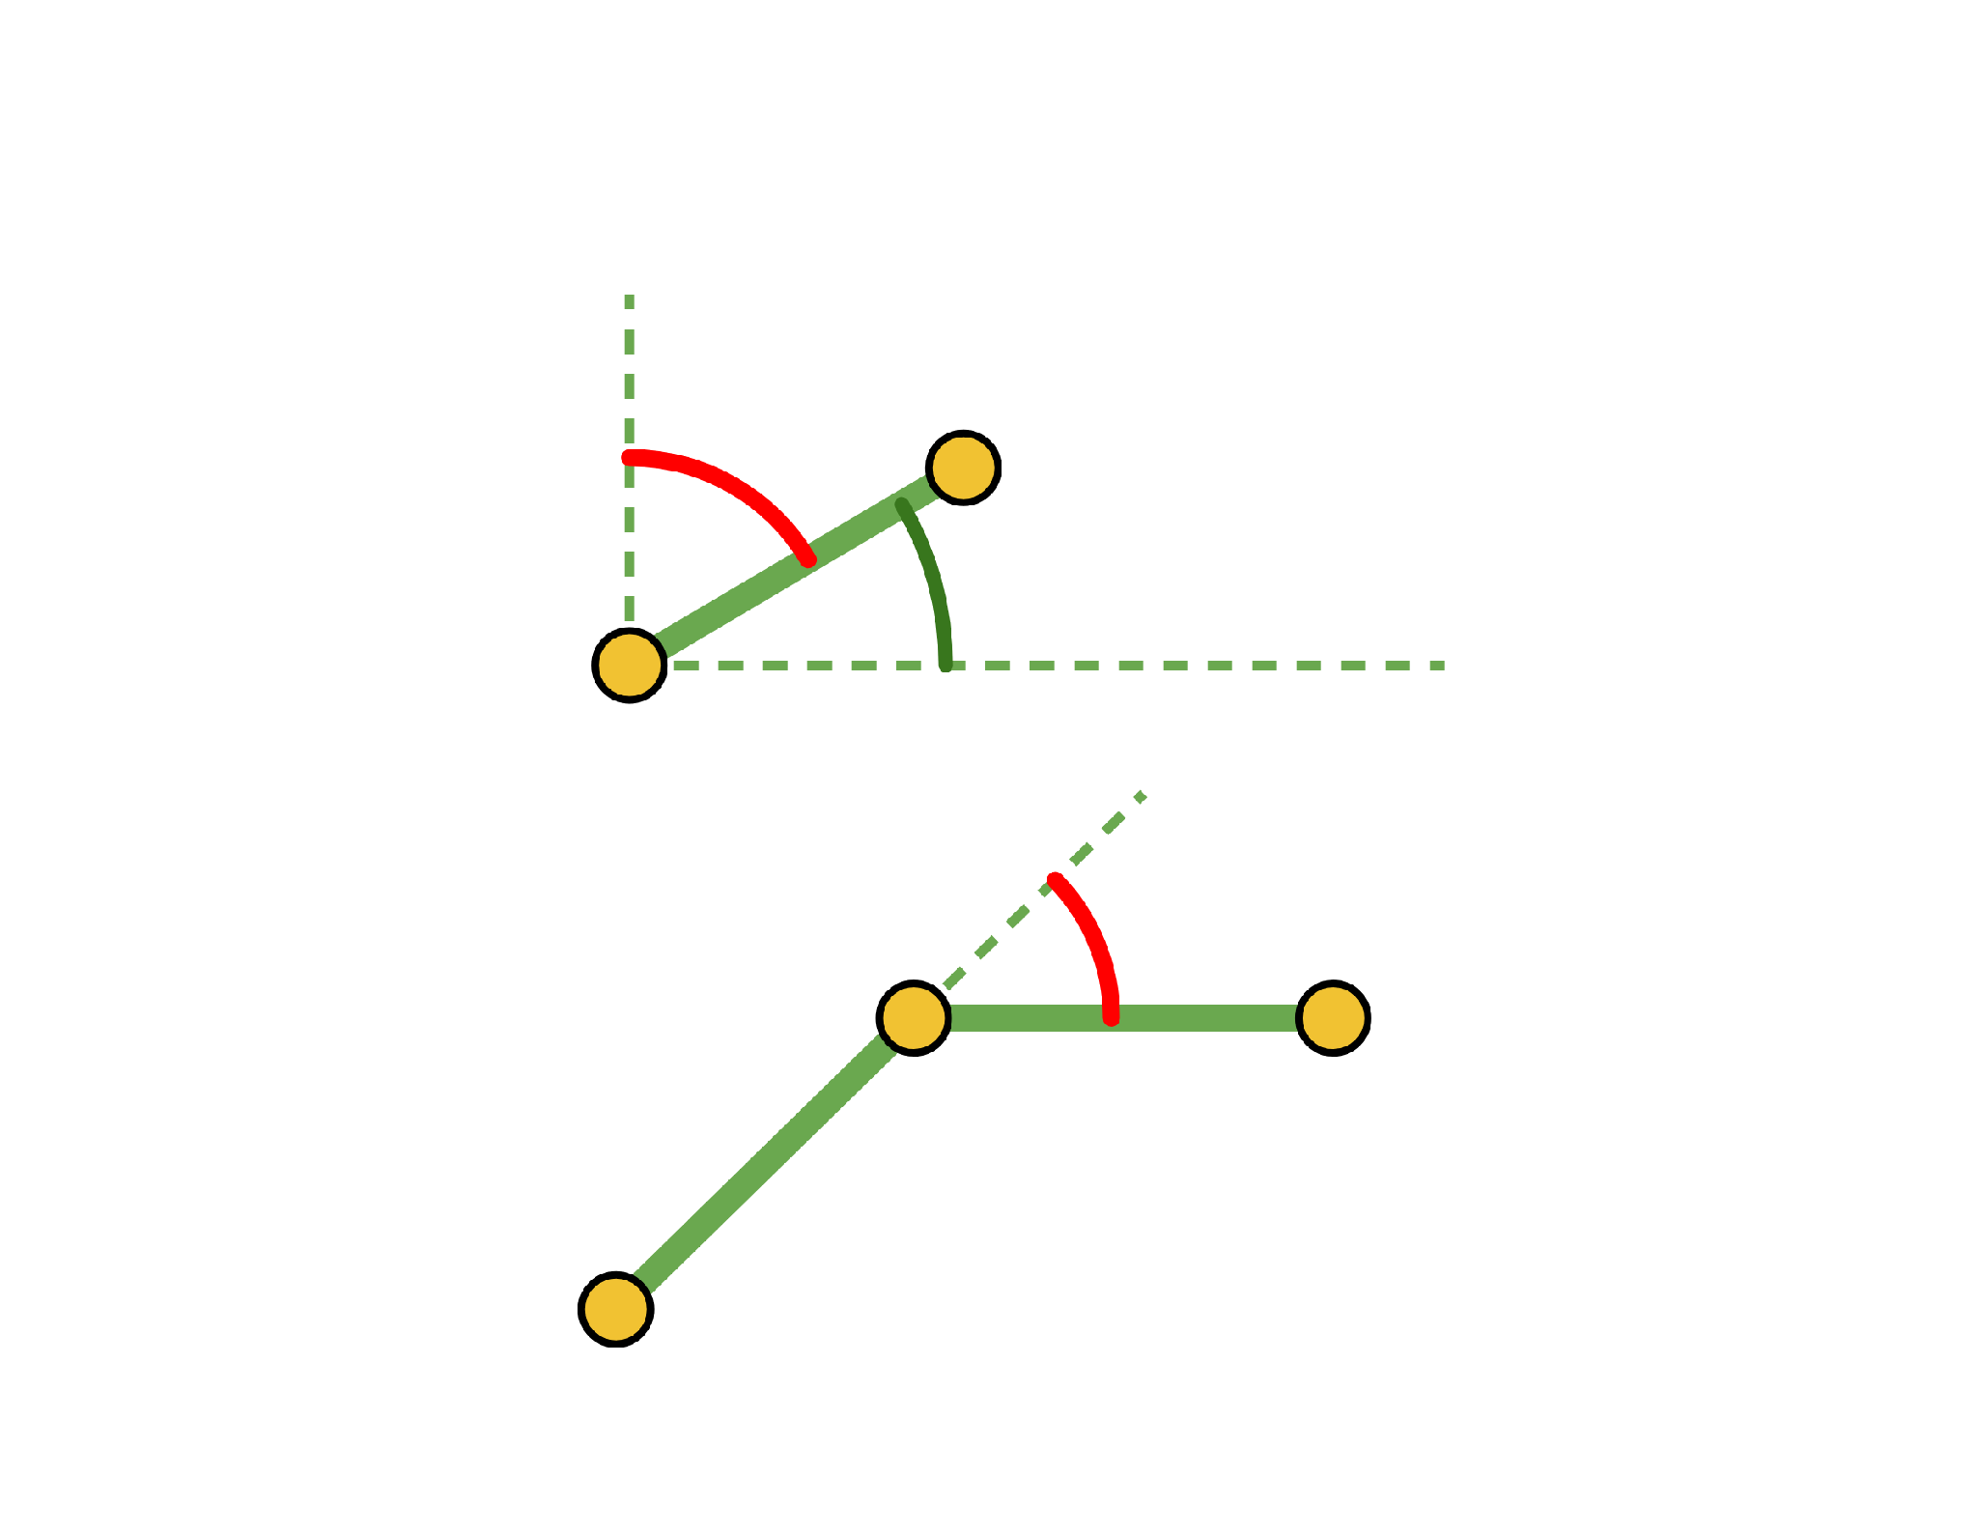
Converting the Arm's Angles
DAY 1 · THE 2D ARM
SHOULDER
θa = 90° − θS
θS = 60°
A matrix counts angles counter-clockwise from the x-axis. θS counts clockwise from the vertical.
θa = 30°
ELBOW
θb = −θE
θE = 45°
The forearm bends clockwise. A matrix counts counter-clockwise, so the sign flips.
clockwise, so θb = −45°
θS = 60° gives θa = 30°
θE = 45° gives θb = −45°

Slide 12
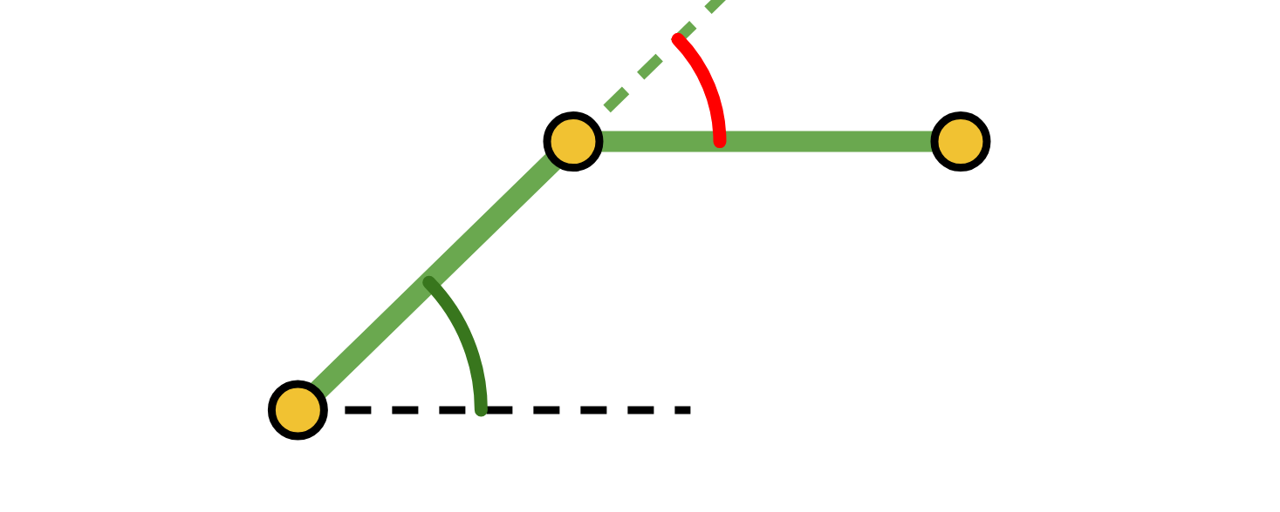
Worked Example: Setup
θb = −45°
DAY 1 · THE 2D ARM
θa = 45°
Find the end effector for θS = 45° and θE = 45°, with L₁ = L₂ = 250 mm.
CONVERT THE ANGLES
THE MOVES
θa = 90° − 45° = 45°
Both links are 250 mm
θb = −45°
Both moves are T(250, 0)
THE CHAIN, APPLIED TO THE POINT (0, 0, 1)
R(45°)
·
T(250, 0)
·
R(−45°)
·
T(250, 0)
·
(0, 0, 1)
step 4
step 3
step 2
step 1
start
The story reads left to right; the arithmetic starts at the right, with the matrix next to the point.

Slide 13
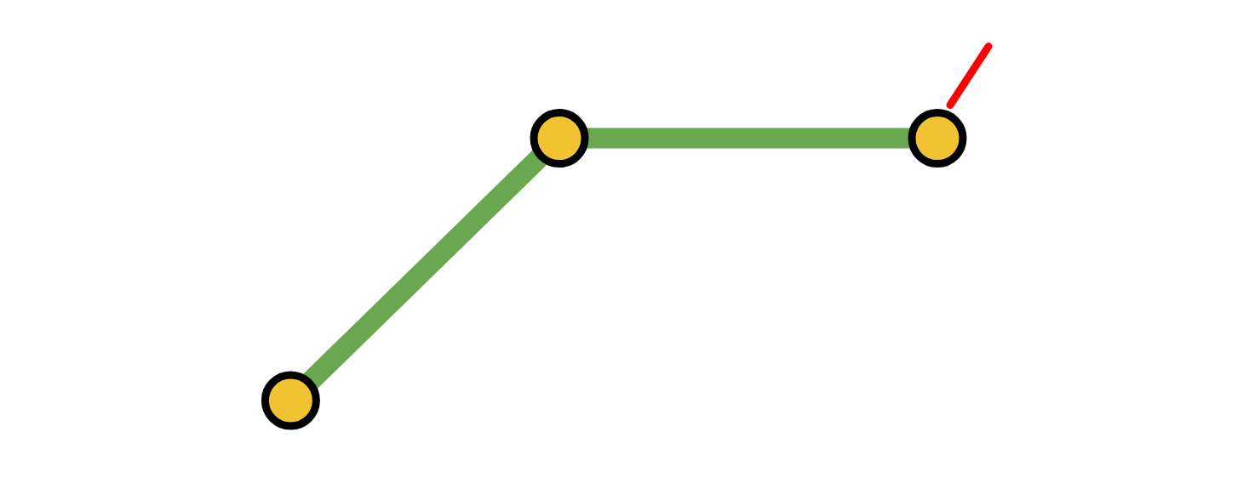
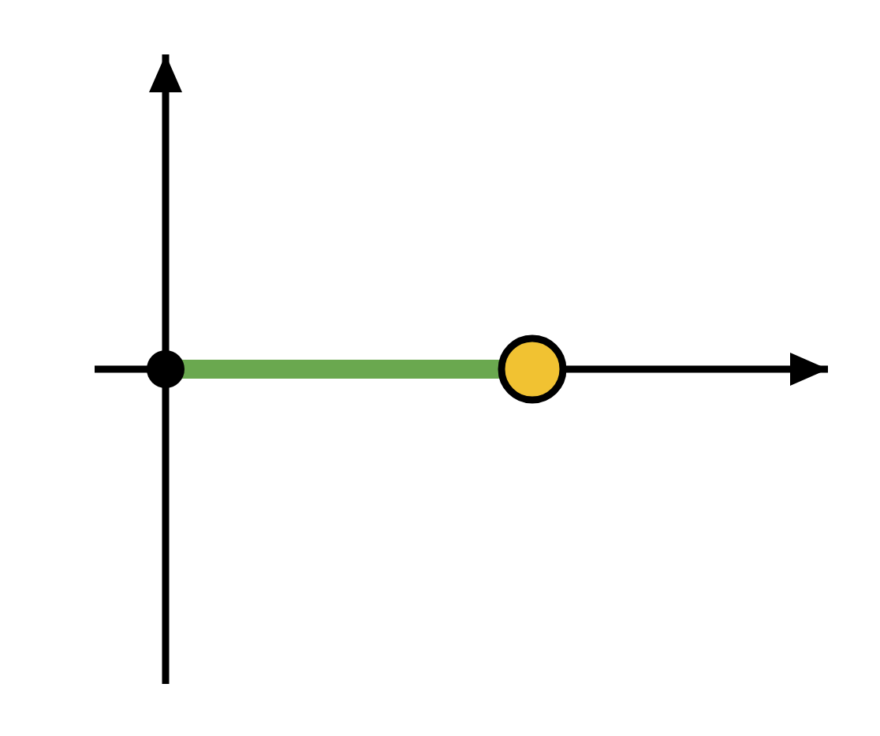
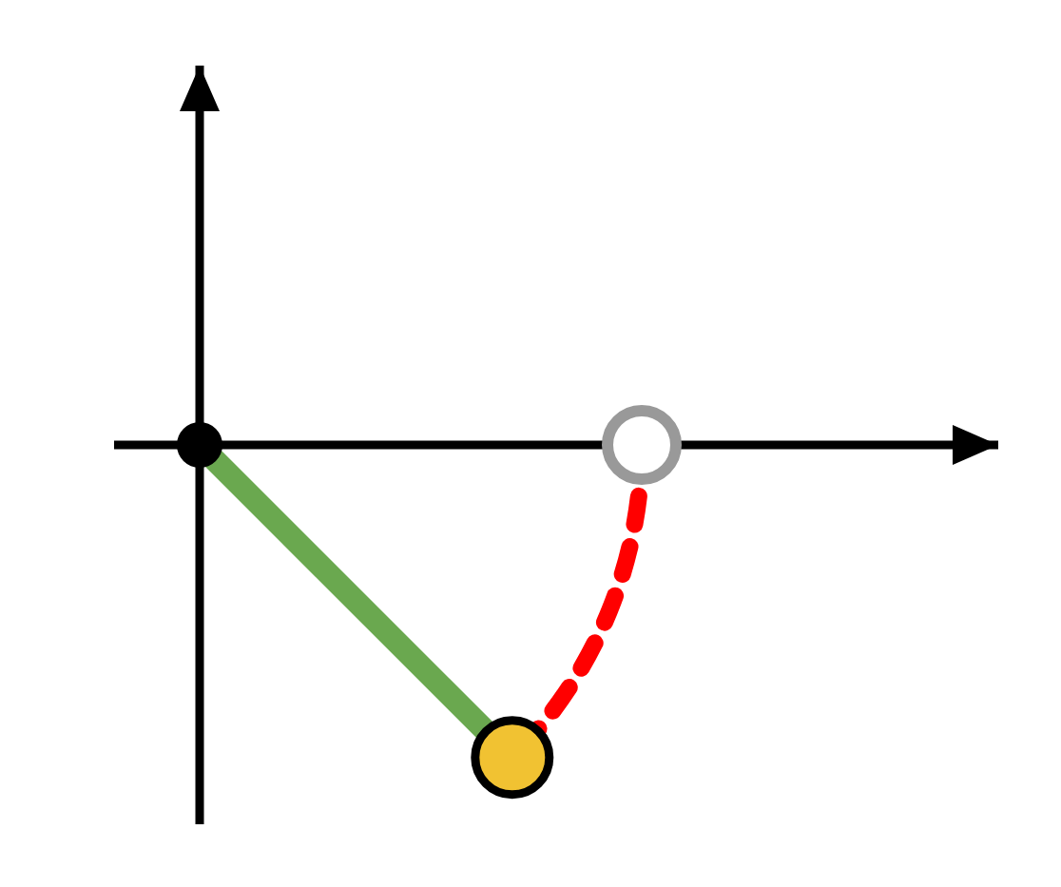
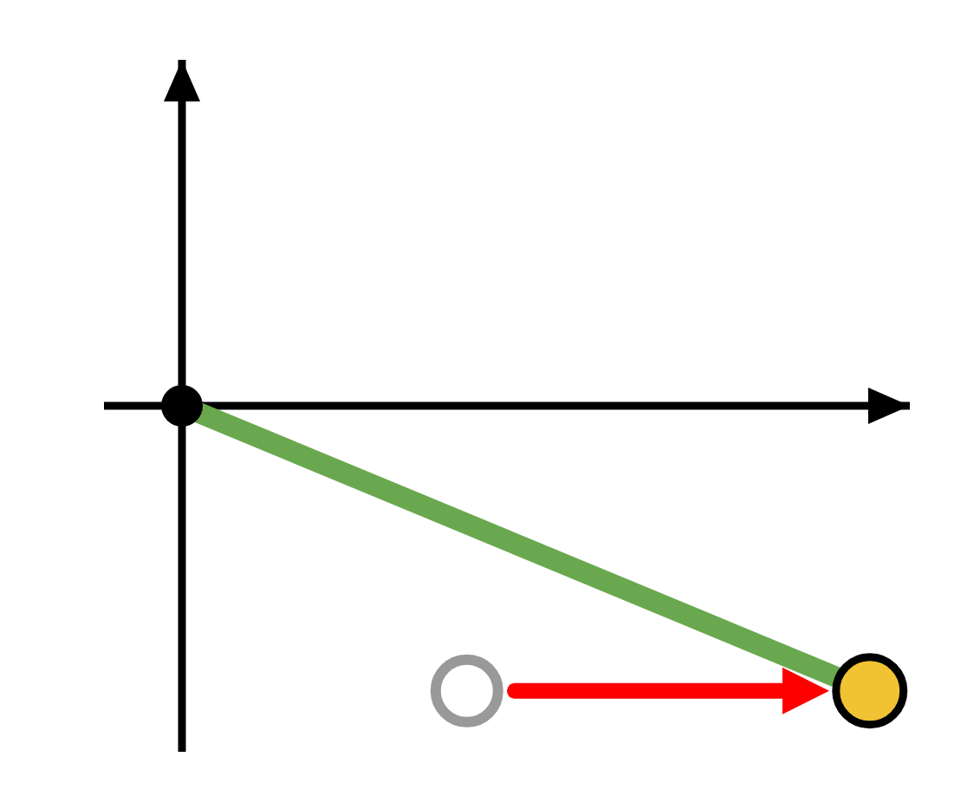
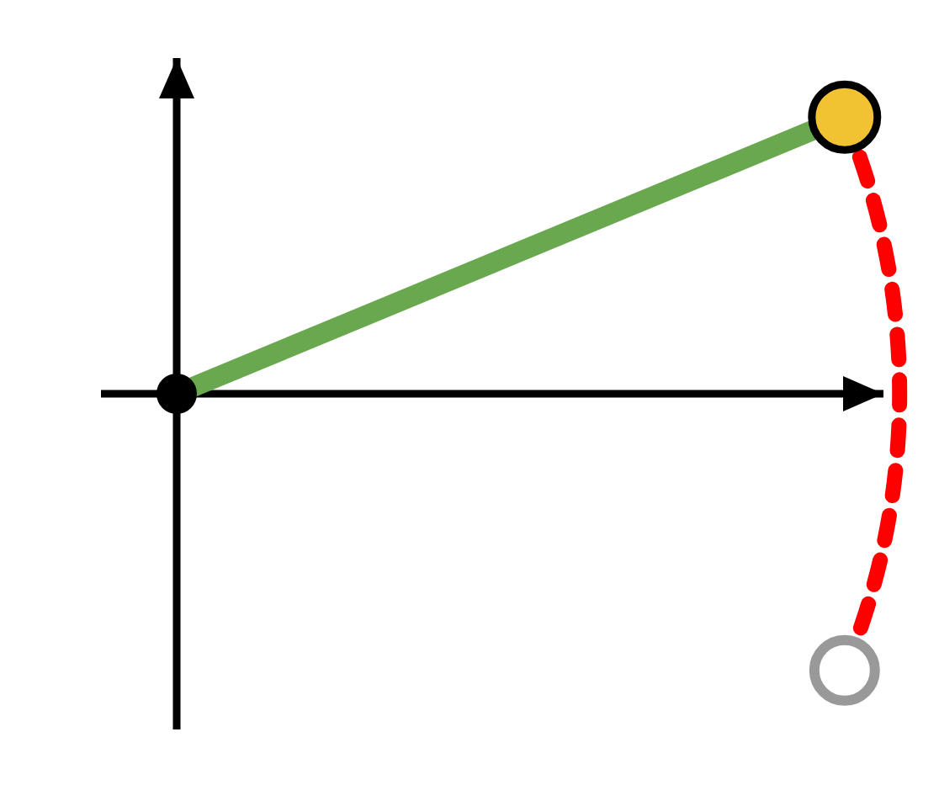
Worked Example: Right to Left
(X, Y)
DAY 1 · THE 2D ARM
Each step is one matrix times the current point.
STEP 1 · T(250, 0)
STEP 2 · R(−45°)
STEP 3 · T(250, 0)
STEP 4 · R(45°)
Lay the forearm out along x
Bend the elbow
Add the upper arm
Swing everything up to the shoulder angle
(250, 0)
(176.78, −176.78)
(426.78, −176.78)
(426.78, 176.78)

Slide 14
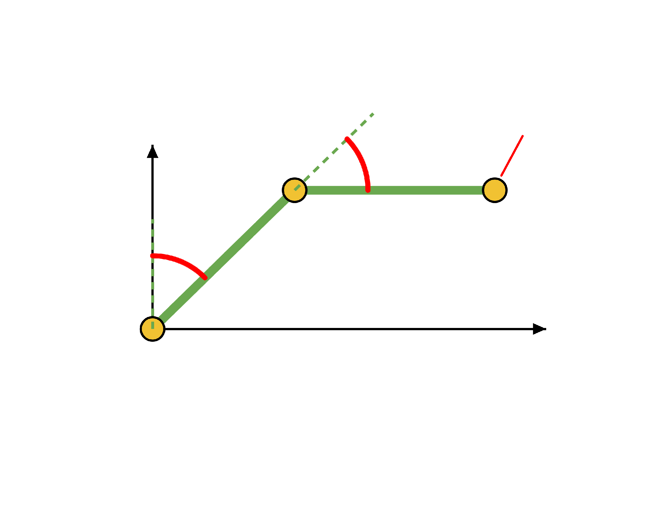
Completed Variables
DAY 1 · THE 2D ARM
L₁ = 250 mm
L₂ = 250 mm
θS = 45°
(X, Y)
Y
θE
θE = 45°
θa = 45°
θS
θb = −45°
(X, Y) = (426.78, 176.78)
X
(0, 0)
Lesson 3's triangles gave (426.777, 176.777). The matrices agree.

Slide 15
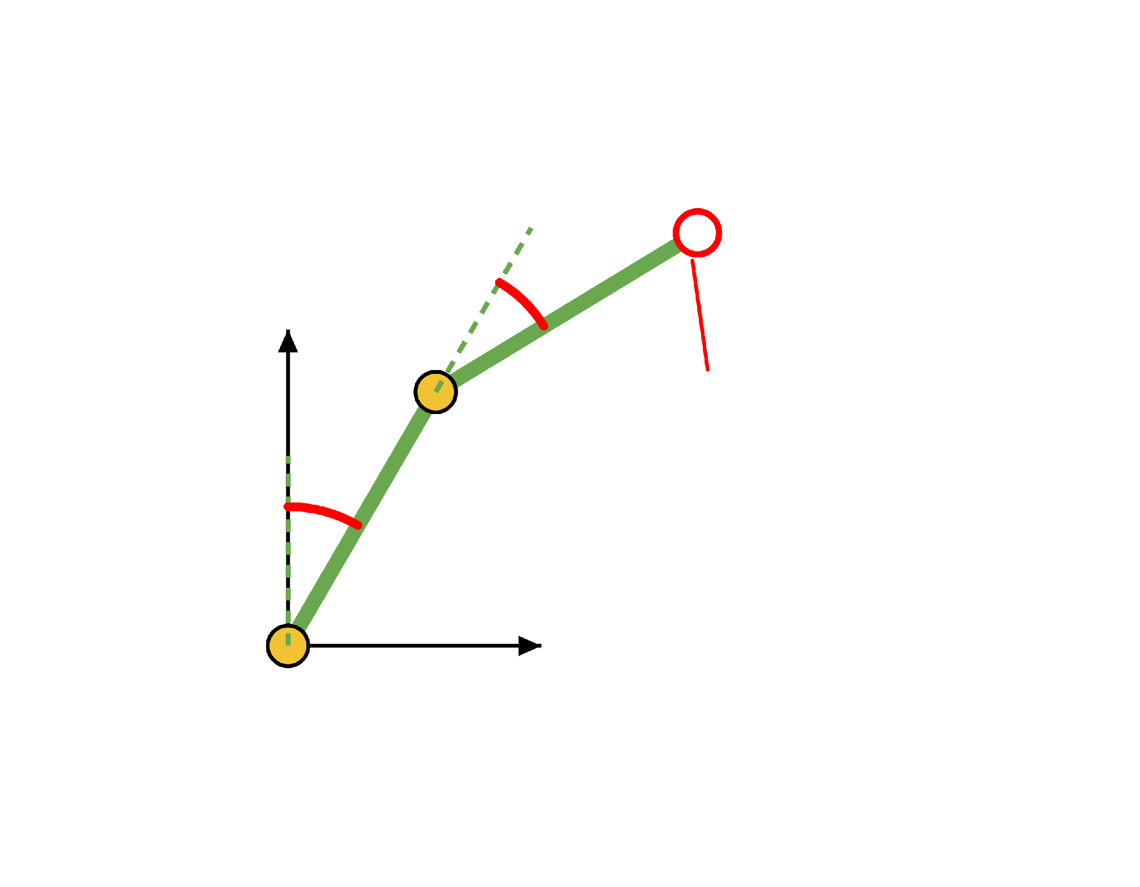
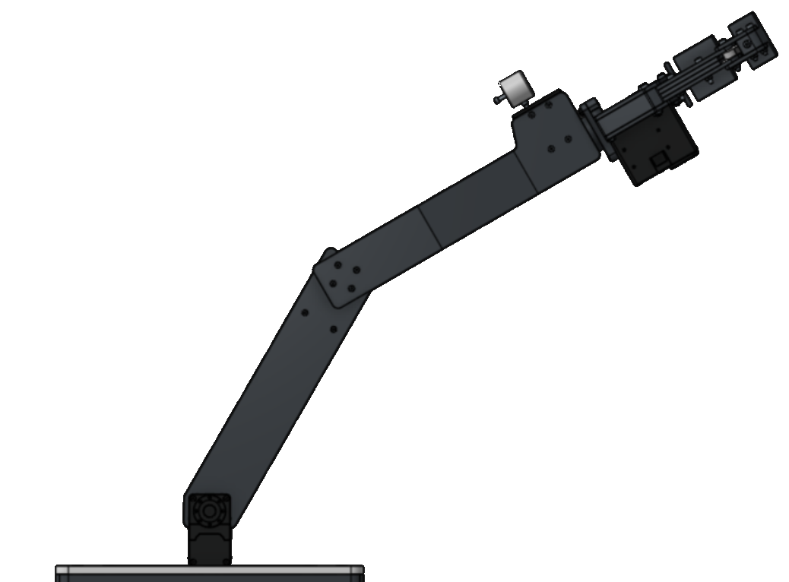
Try It Yourself #2
DAY 1 · TRY IT YOURSELF
Find the end effector (X, Y).
L₁ = 250 mm
L₂ = 250 mm
θE
θS = 30°
y
θE = 30°
(X, Y) = (?, ?)
θS
SOLUTION
θa = 90° − 30° = 60°, θb = −30°
x
(X, Y) = (341.51, 341.51)
The same answer as Try It Yourself in Lesson 3.

Slide 16
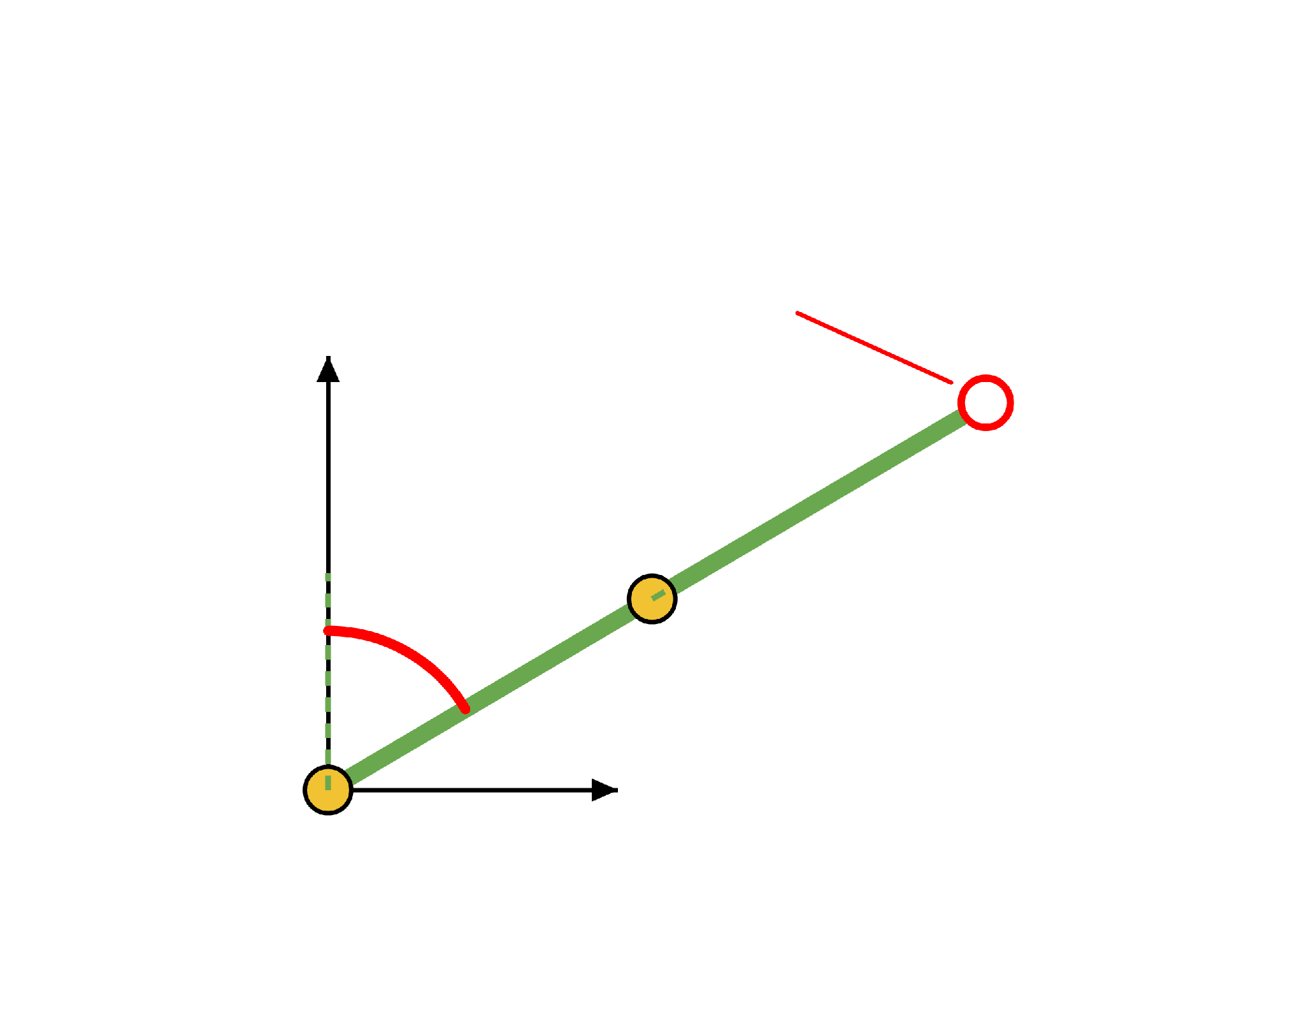
Try It Yourself #3
DAY 1 · TRY IT YOURSELF
Find the end effector (X, Y).
L₁ = 250 mm
L₂ = 250 mm
(X, Y) = (?, ?)
θS = 60°
y
θE = 0°
θS
SOLUTION
θa = 90° − 60° = 30°, θb = 0°
θE = 0°
(X, Y) = (433.01, 250.00)
x
A 0° turn changes nothing, so the arm is one straight line.

Slide 17

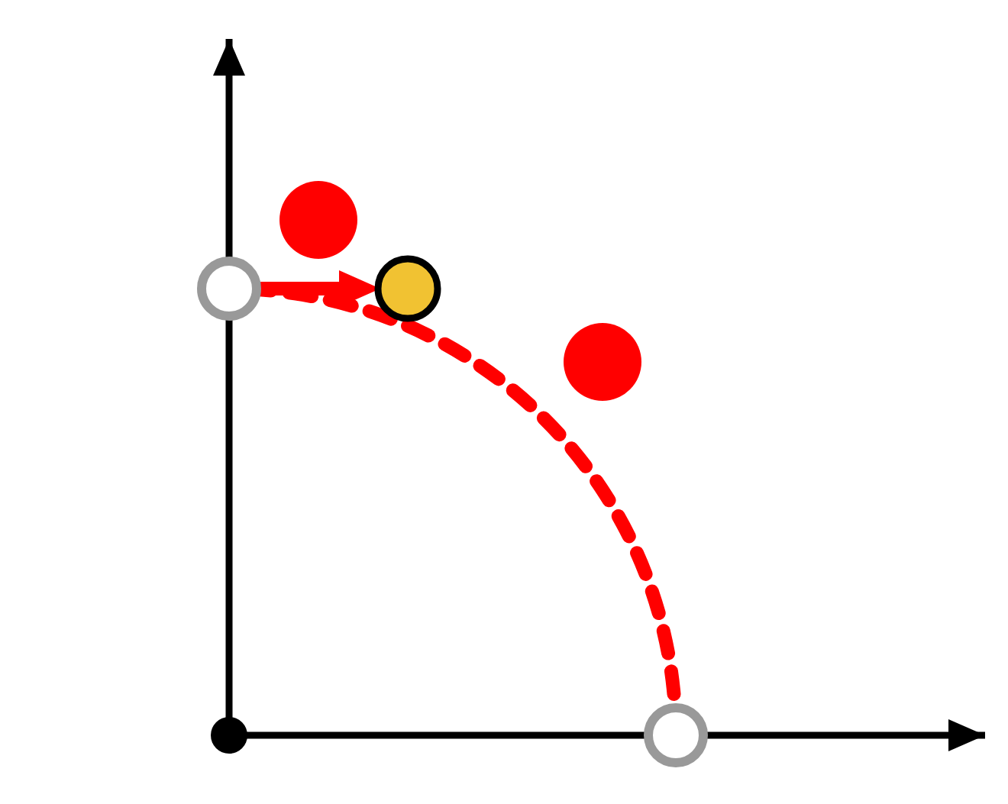
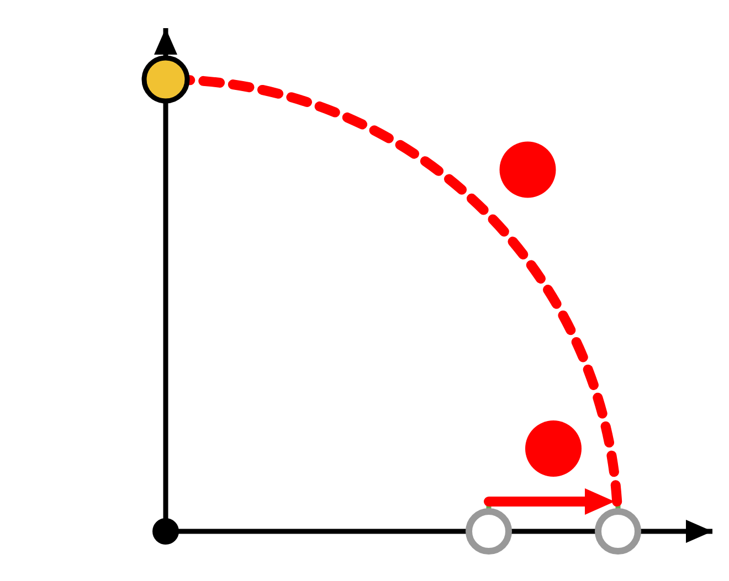
Order Matters
3
4
DAY 1 · ORDER MATTERS
2
1
A · ROTATE, THEN MOVE
B · MOVE, THEN ROTATE
T(100, 0) · R(90°) · P
R(90°) · T(100, 0) · P
2
1 · Rotate: (0, 250)
2
1 · Move: (350, 0)
1
2 · Move: (100, 250)
2 · Rotate: (0, 350)
(100, 250)
(0, 350)
1
Same two matrices, different order, different answer. In the arm's chain, the order of the matrices must match the order of the joints.

Slide 18
Day 1 Recap
(X, Y)
DAY 1 · RECAP
ROTATE
MOVE
R(θ)
T(dx, dy)
Spins a point by θ around the origin.
Moves a point. The extra 1 makes it a matrix.
CHAIN
ORDER
M = R · T · R · T
R · T is not T · R
One matrix per step. Multiply from the right.
Swap two matrices and the answer changes.
Next time: the real arm turns at the base too, so it needs 3D.

Slide 19
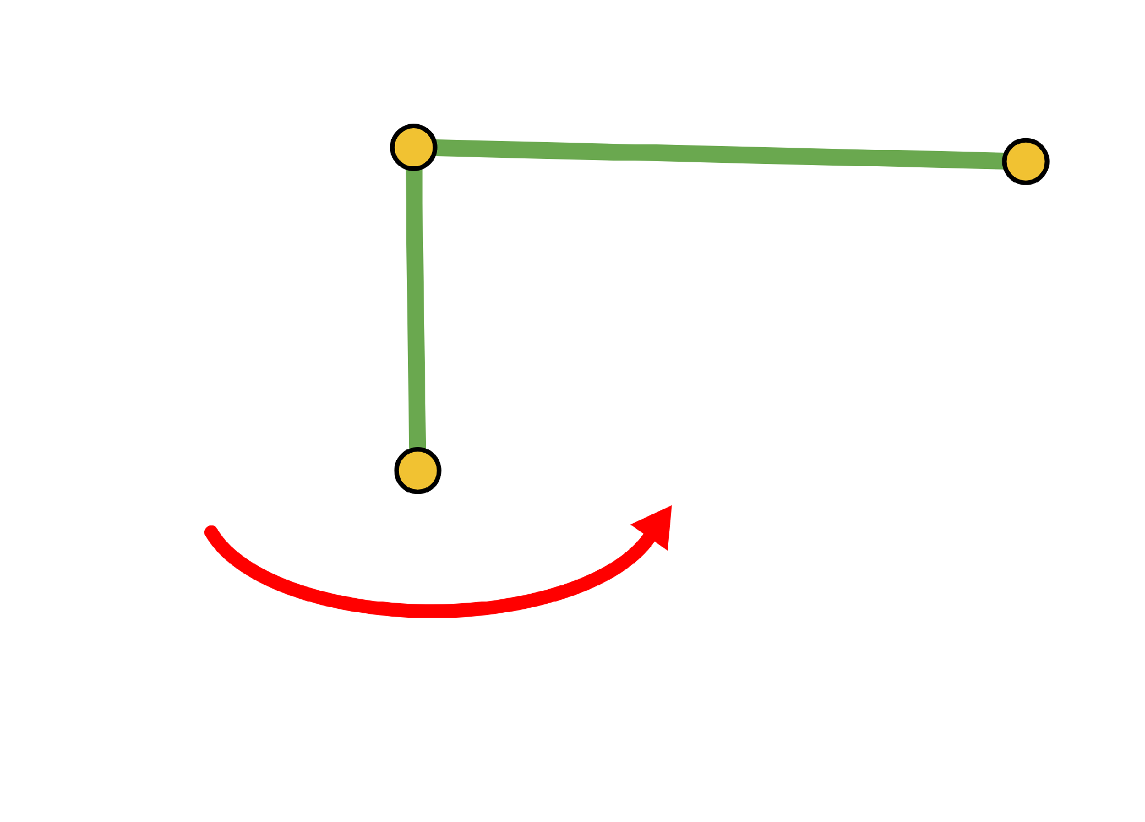
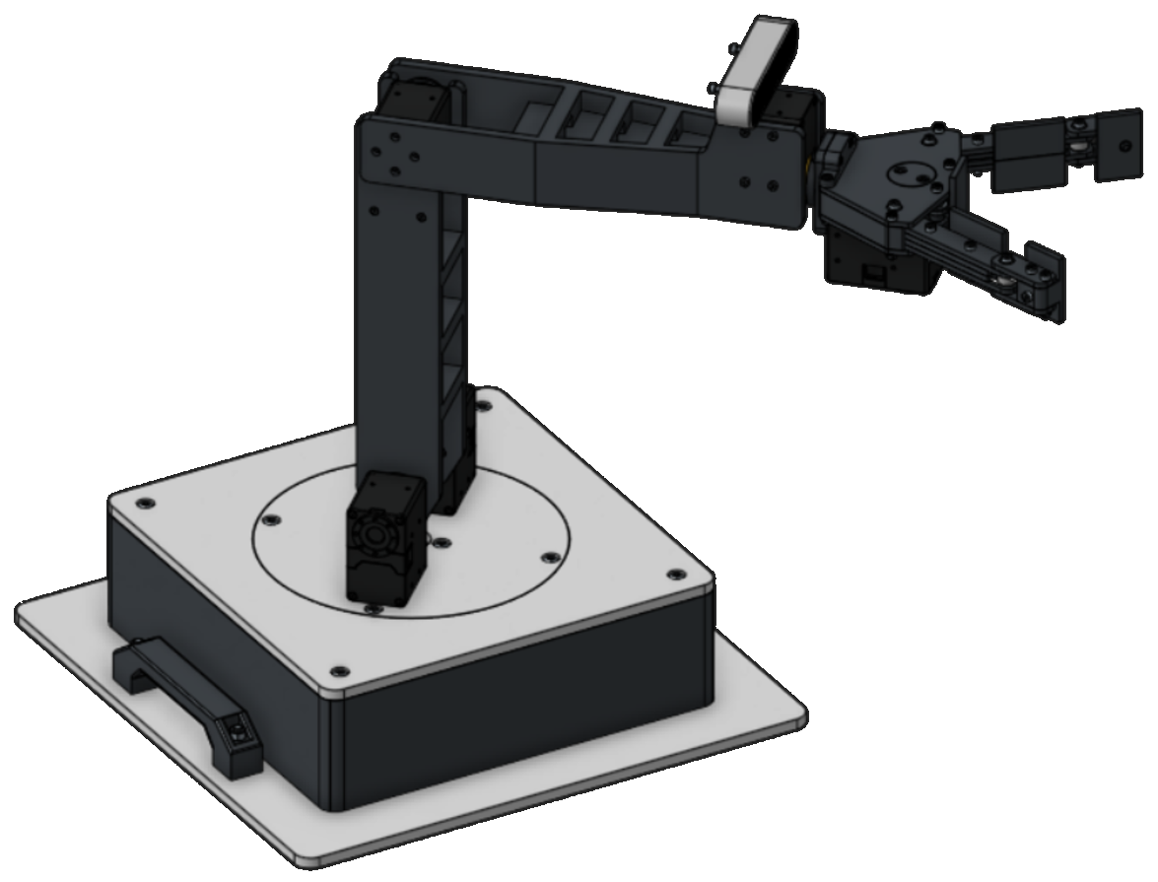
Extending to 3D
DAY 2
θB
Day 1 gave us a recipe for a flat arm. Now the base turns, and the same recipe has to work in three dimensions.
DAY 1 IN ONE LINE
M = R(θa) · T(250, 0) · R(θb) · T(250, 0) → (426.78, 176.78)

Slide 20
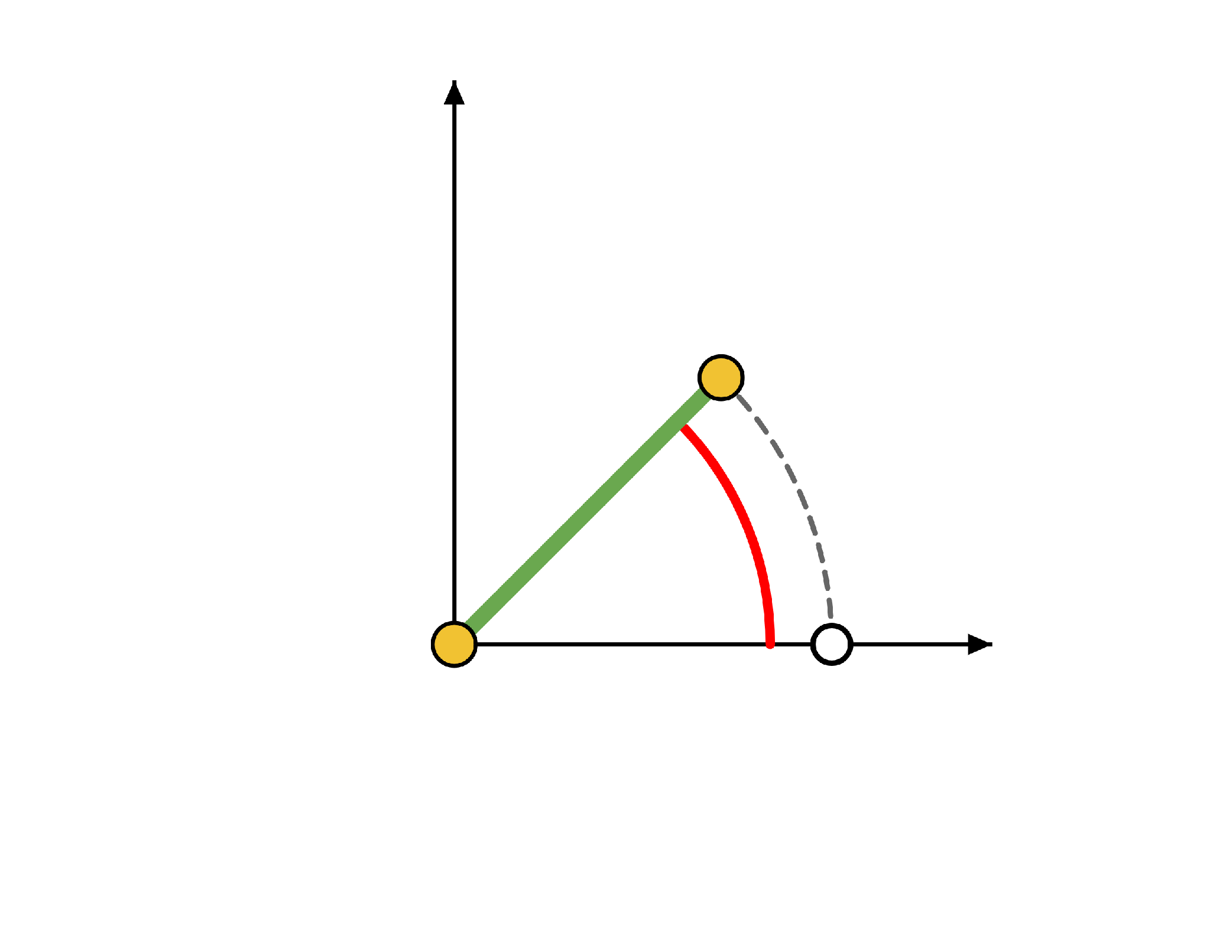
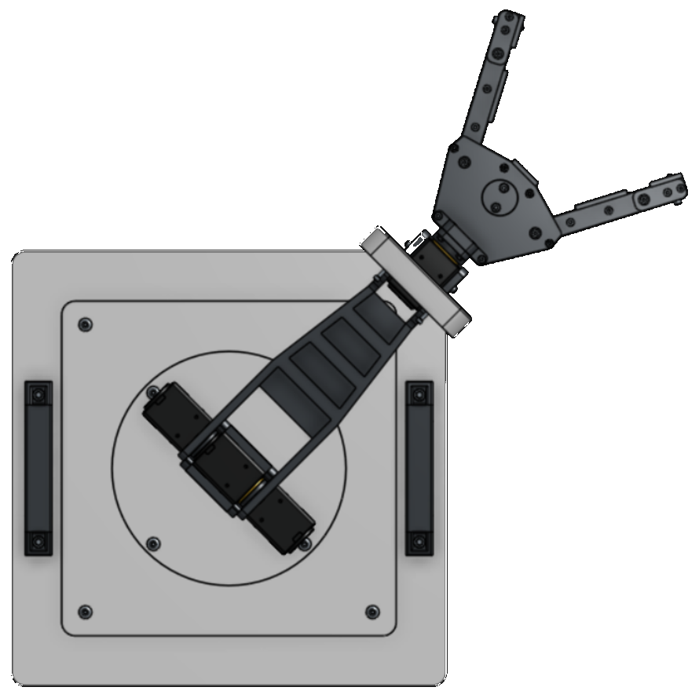
The Base Turns the Whole Arm
DAY 2 · THE BASE
y
1
Day 1's flat arm sits in one vertical plane.
2
The base spins that whole plane around the vertical axis, by θB.
So we need 3D: a point is (x, y, z), and each matrix is 4 × 4.
θB = 45°
3
x
ONE CHANGE OF HABIT
From now on, z points up. Lesson 3 called the
up direction Y.
θB = 0°

Slide 21

Four Numbers Describe Each Joint
a = 250
DAY 2 · THE FOUR NUMBERS
a = 250
Each joint is four simple moves, and each move has one number. The values below are for joints 1, 2, 3: base, shoulder, elbow.
TURN AROUND z
SLIDE ALONG z
SLIDE ALONG x
TURN AROUND x
θ
d
a
α
joint angle
offset
link length
link twist
How far the joint has turned.
How far the next link is shifted along the joint's axis.
How long the link is.
How much the next
joint's axis is tilted.
OUR ARM
OUR ARM
OUR ARM
OUR ARM
the only number that changes
0 · 0 · 0
0 · 250 · 250 mm
90° · 0° · 0°

Slide 22

One Matrix per Joint
3
DAY 2 · THE DH MATRIX
2
1
A = Rz(θ) · Tz(d) · Tx(a) · Rx(α)
turn about z, slide along z, slide along x, turn about x
Top-left 3 × 3
how the new frame is turned
cos θ
−sin θ cos α
sin θ sin α
a cos θ
Last column
sin θ
cos θ cos α
−cos θ sin α
a sin θ
where the new frame's origin is
A =
0
sin α
cos α
d
Bottom row
0
0
0
1
always 0 0 0 1
We never expand this by hand.
We plug in one row of the DH
table.

Slide 23
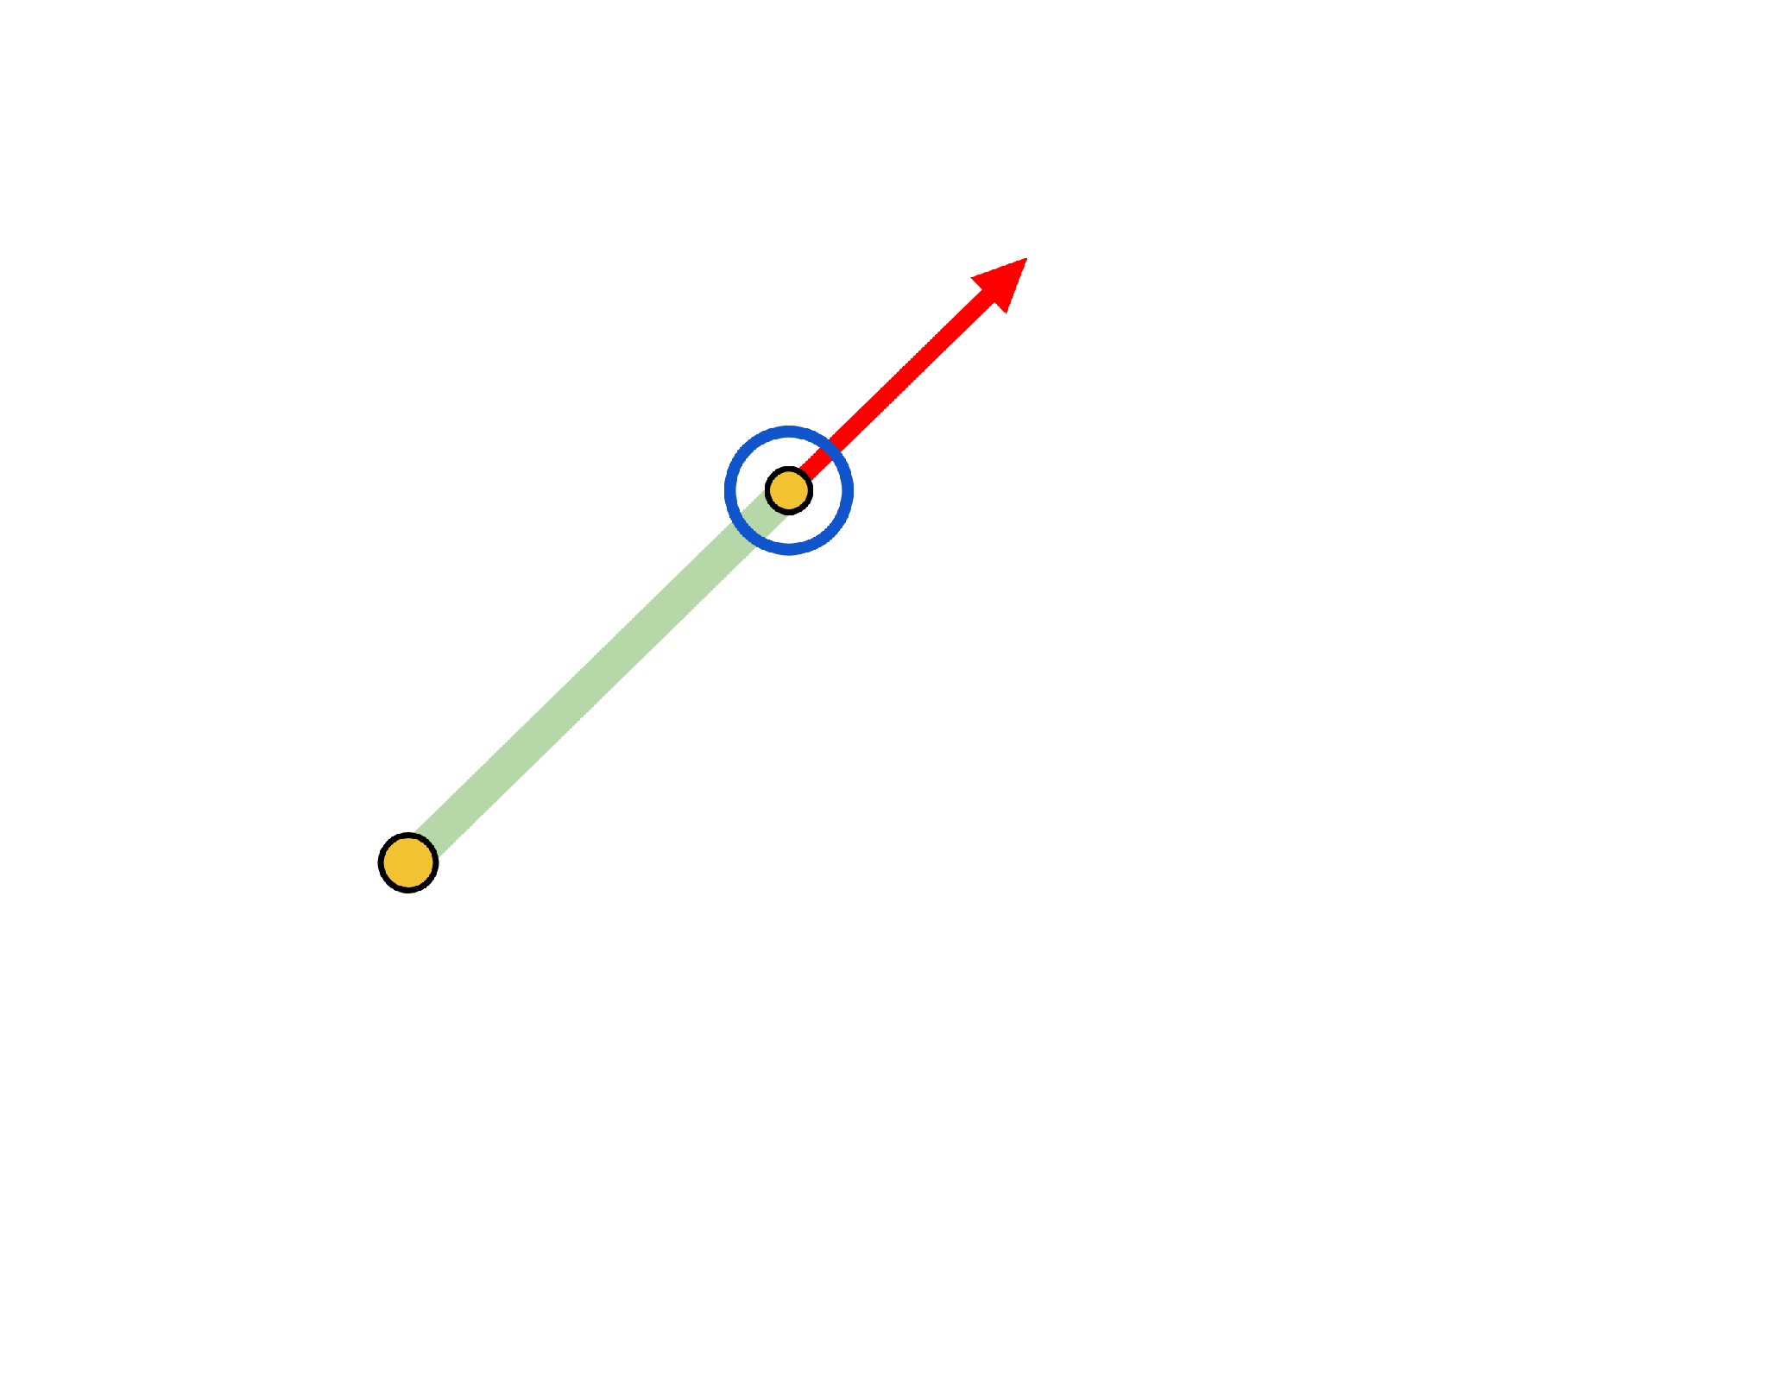
Placing a Frame on Each Joint
DAY 2 · FRAMES
z
z points along the axis the joint turns around.
x
z: out of the page
x
x points along the link, away from the previous joint.
link
the frame at this joint
y is never needed. Once x and z are set, y follows.
previous joint
NUMBERING
Frame 0 is fixed on the base. Each later frame sits at the end of a link.

Slide 24
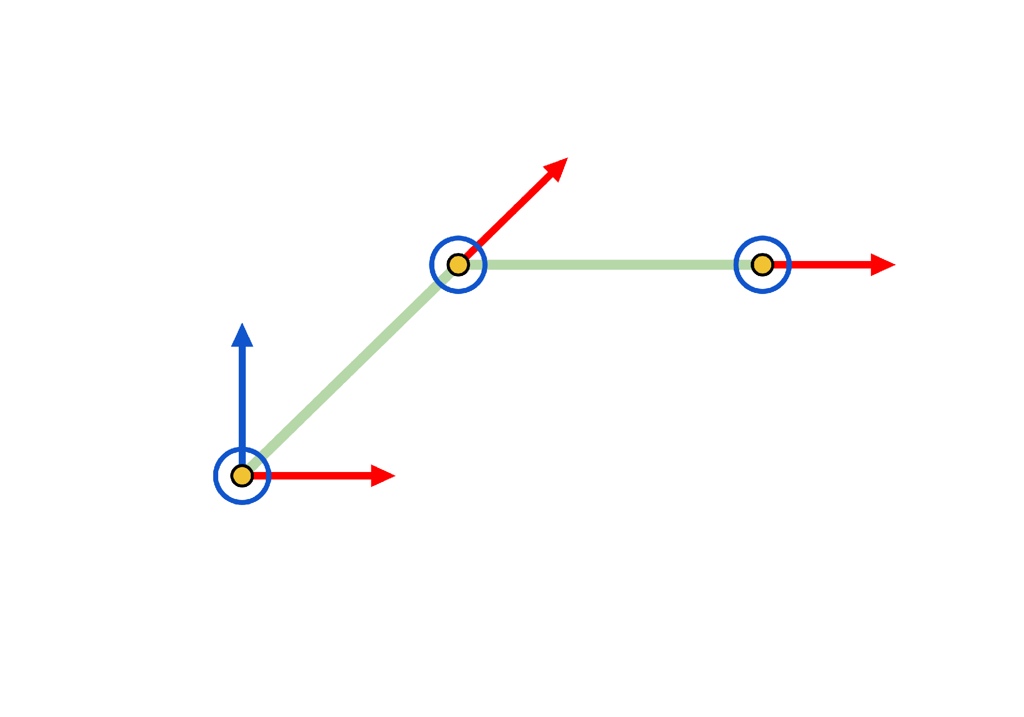
Frames on Our Arm
DAY 2 · FRAMES
F₀ F₁
Base and shoulder
z₀ points up (the base axis). z₁ comes out of the page (the shoulder axis). Both frames share one origin, since a = 0 and d = 0 for the base.
x₂
F₂
x₃
F₂
Elbow
z₀
F₃
z₂ comes out of the page (the elbow axis).
x₂ runs along the upper arm.
F₀ F₁
x₀ = x₁
F₃
Tip
z₃ copies z₂. x₃ runs along the forearm.

Slide 25
Fill In the DH Table
Elbow
3
DAY 2 · THE DH TABLE
Shoulder
Base
2
1
Joint
θ
d
a
α
ROW i
Row i takes you from frame i − 1 to frame i.
1 · Base
?
?
?
?
ASK YOURSELF
θ: what is the joint's angle?
2 · Shoulder
?
?
?
?
d: does anything slide along z?
a: how long is the link along x?
α: is the next z axis tilted?
3 · Elbow
?
?
?
?

Slide 26
The DH Table for Our Arm
Elbow
3
DAY 2 · THE DH TABLE
250
250
Shoulder
Base
2
1
Joint
θ
d
a
α
θ column
These change with the pose. The rest are fixed.
1 · Base
θB
0
0
90°
Shoulder
θS is measured from vertical, θ from horizontal: θ = 90° − θS.
2 · Shoulder
90° − θS
0
250
0°
Elbow
The elbow bends clockwise, θ counts counter-clockwise: θ = −θE.
3 · Elbow
−θE
0
250
0°
α = 90°
Only the base twists: the shoulder axis
is tilted 90° from the base axis.

Slide 27
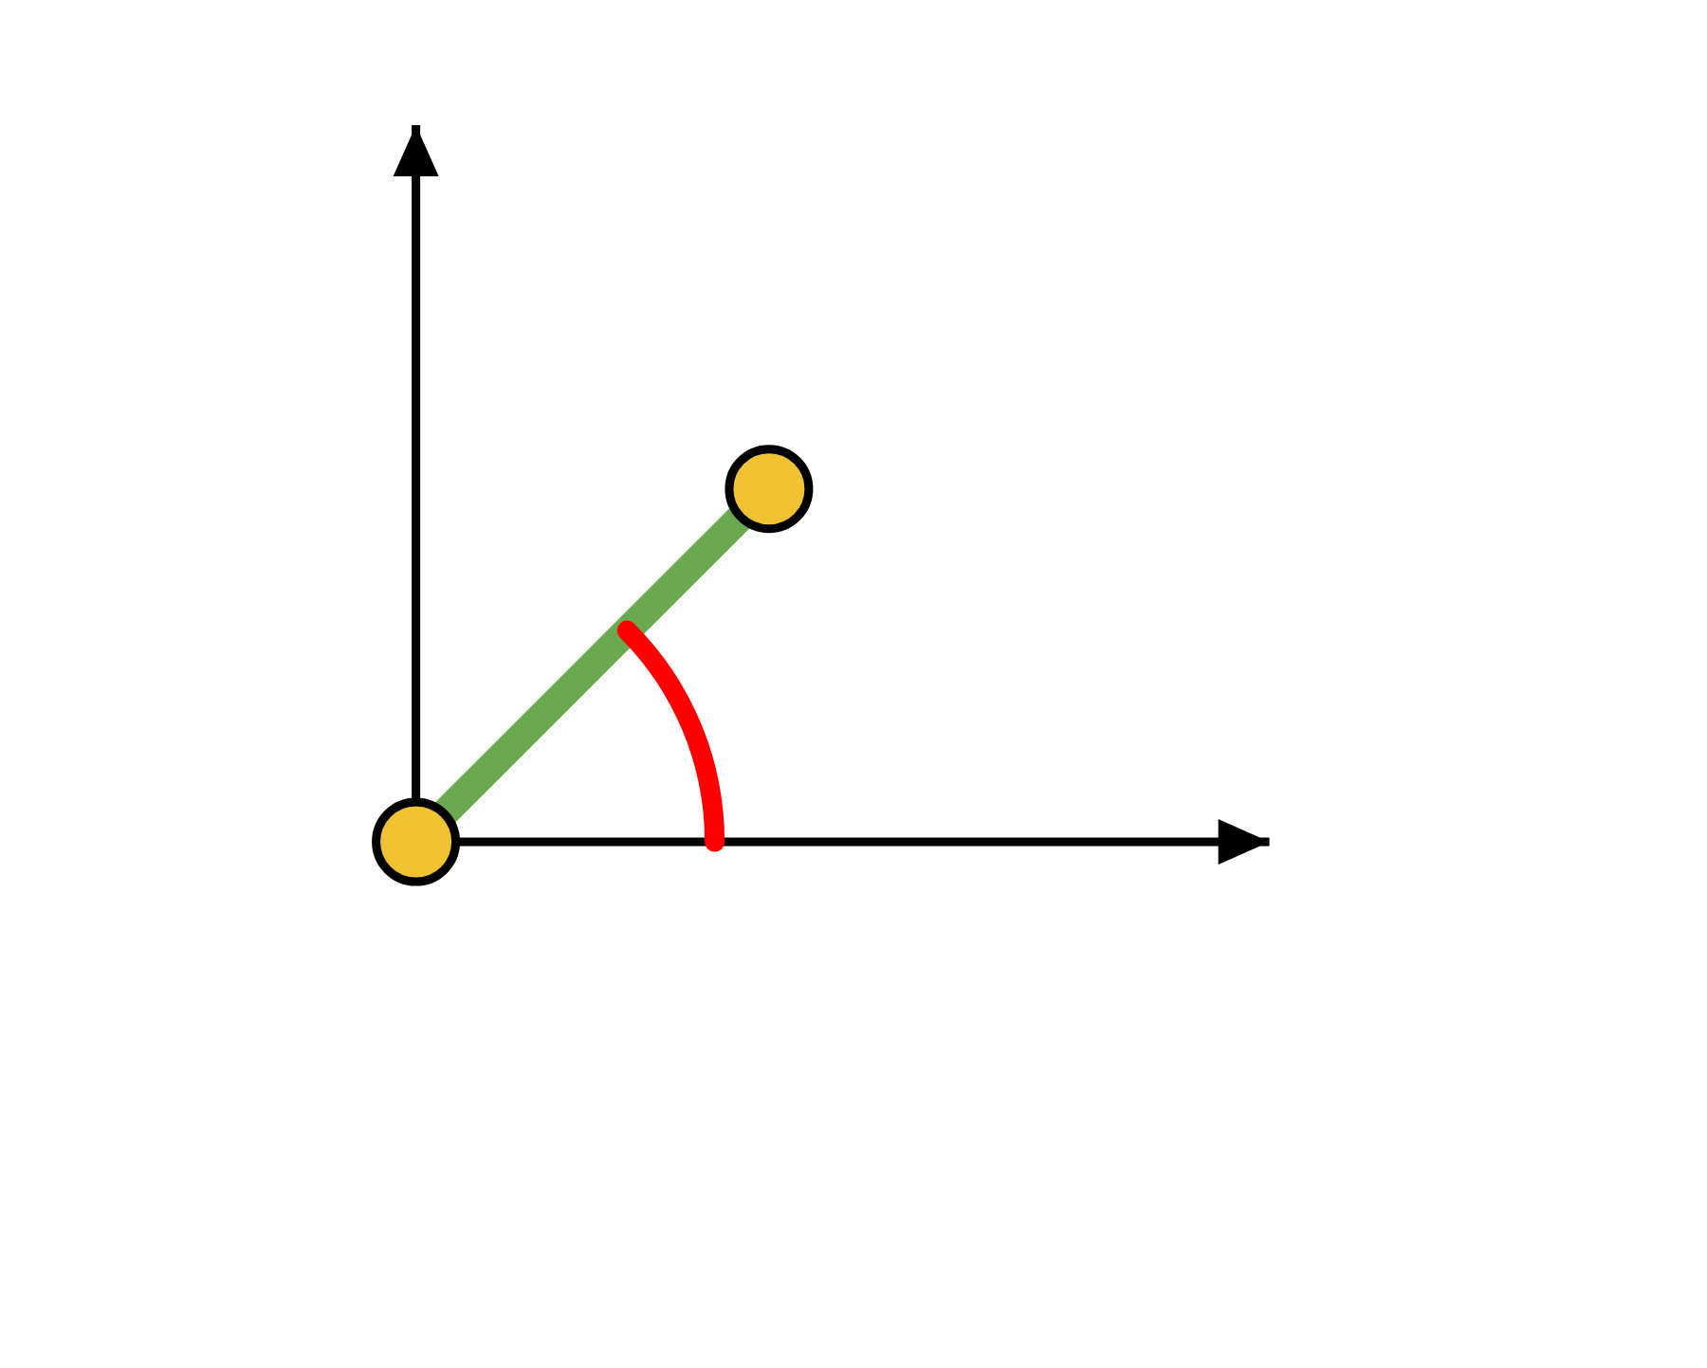
A₁: The Base
DAY 2 · WORKED EXAMPLE
Pose: θB = 45°, θS = 45°, θE = 45°
ROW 1
θ = θB = 45° · d = 0 · a = 0 · α = 90°
y
0.7071
0
0.7071
0
0.7071
0
−0.7071
0
A₁ =
0
1
0
0
0
0
0
1
θB = 45°
x
turns the frame
where it sits
F₀ F₁
HOW TO READ IT
Last column (0, 0, 0): frame 1 sits at the same point as frame 0. Only the direction of its axes changes.

Slide 28
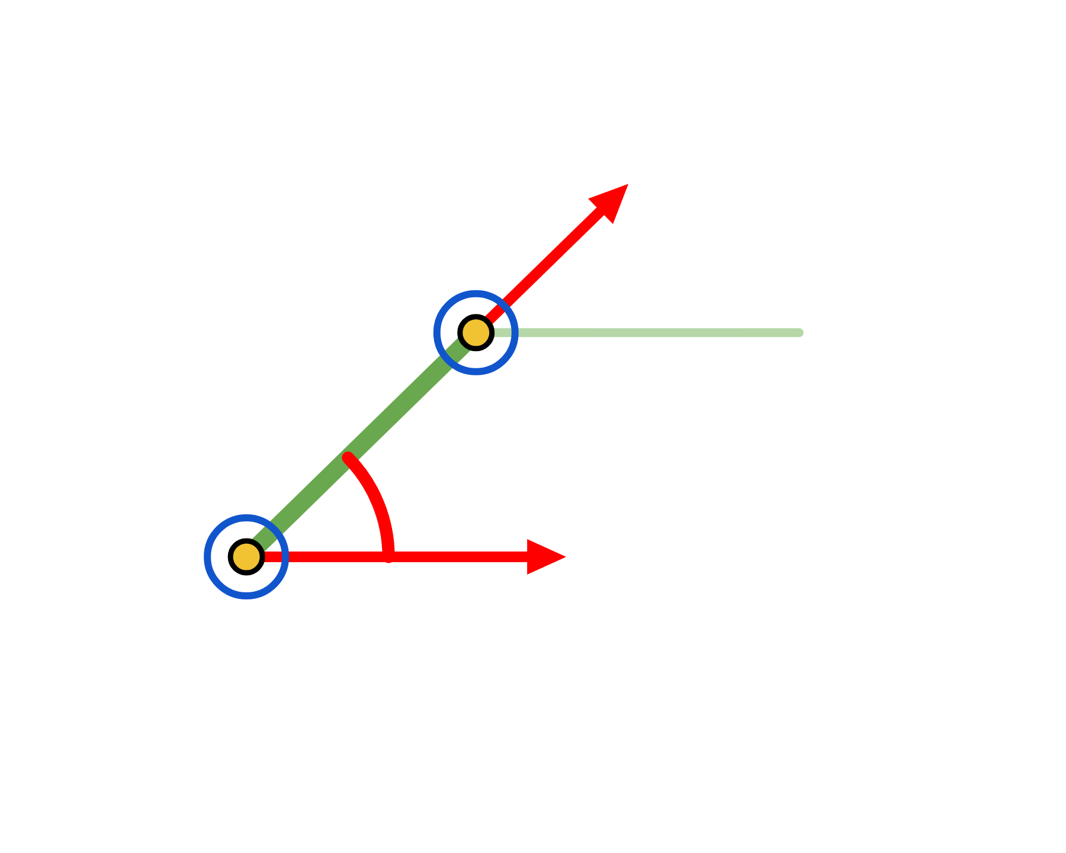
A₂: The Shoulder
DAY 2 · WORKED EXAMPLE
Pose: θB = 45°, θS = 45°, θE = 45°
ROW 2
θ = 90° − θS = 45° · d = 0 · a = 250 · α = 0°
0.7071
−0.7071
0
176.78
x₂
0.7071
0.7071
0
176.78
A₂ =
F₂
0
0
1
0
0
0
0
1
θ = 45°
turns the frame
where it sits
F₁
x₁
HOW TO READ IT
Last column (176.78, 176.78, 0): frame 2 sits 176.78 mm along x₁ and
176.78 mm along y₁, measured in frame 1.

Slide 29
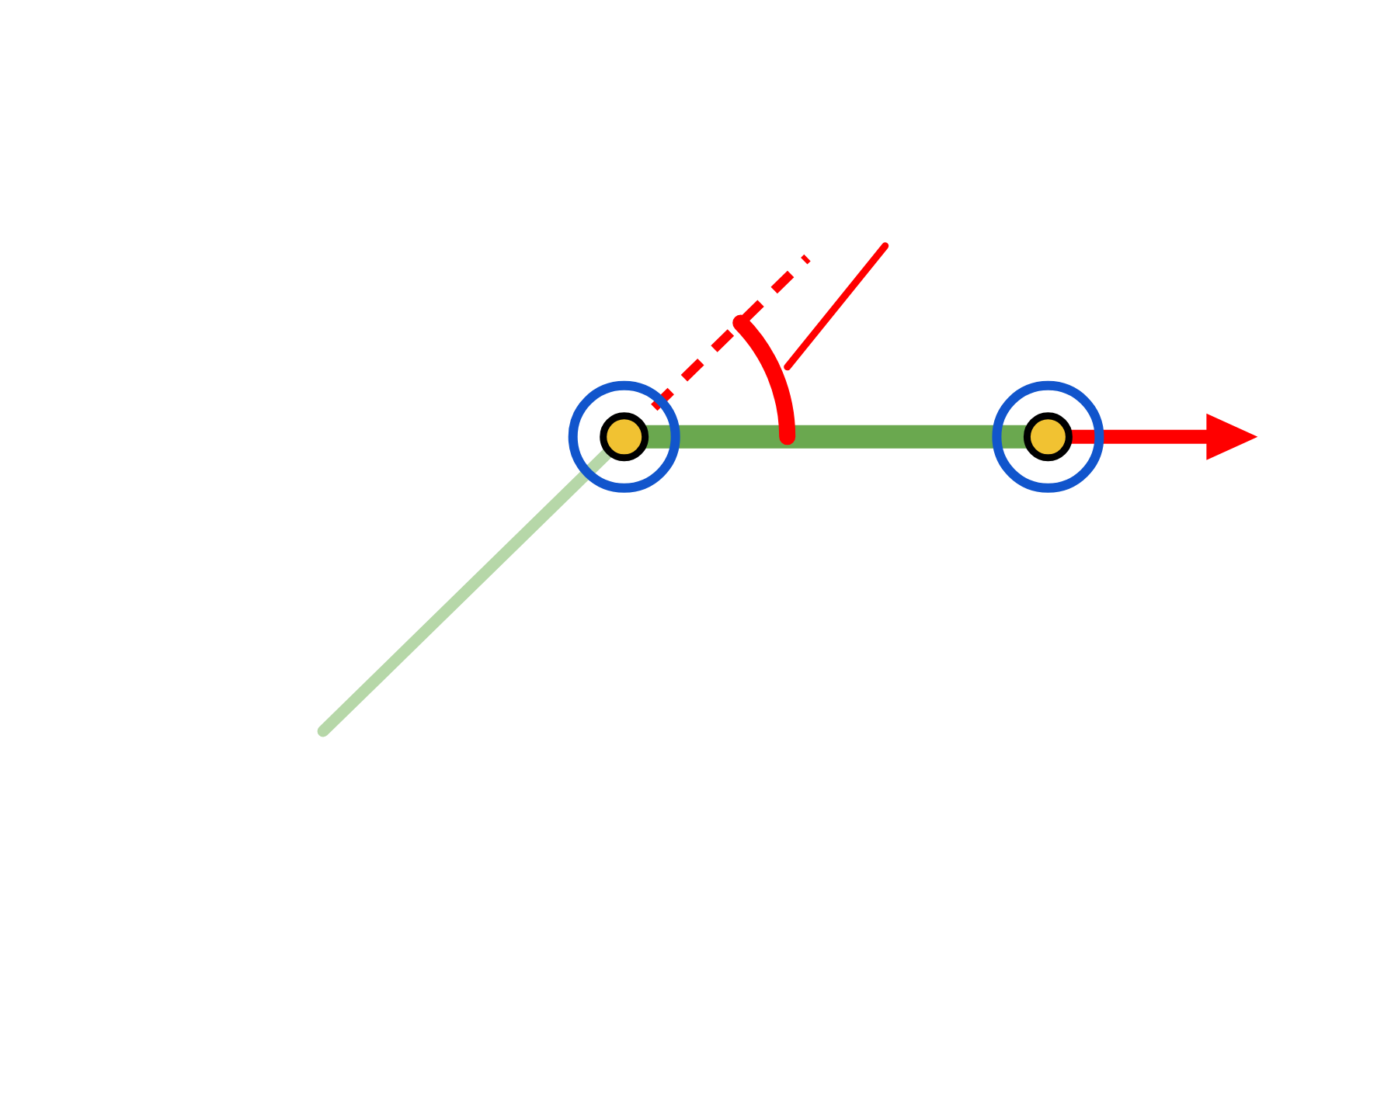
A₃: The Elbow
DAY 2 · WORKED EXAMPLE
Pose: θB = 45°, θS = 45°, θE = 45°
ROW 3
θ = −θE = −45° · d = 0 · a = 250 · α = 0°
0.7071
0.7071
0
176.78
x₂
−45°
−0.7071
0.7071
0
−176.78
A₃ =
F₂
0
0
1
0
x₃
0
0
0
1
F₃
turns the frame
where it sits
HOW TO READ IT
Last column (176.78, −176.78, 0): frame 3 sits 176.78 mm along x₂ and −176.78 mm along y₂, measured in frame 2.

Slide 30

Step 1: Multiply A₂ · A₃
DAY 2 · WORKED EXAMPLE
A₂
A₃
A₂ and A₃ have parallel z axes, so together they are the flat arm of Day 1.
0.7071
−0.7071
0
176.78
0.7071
0.7071
0
176.78
1
0
0
426.78
0.7071
0.7071
0
176.78
×
−0.7071
0.7071
0
−176.78
=
0
1
0
176.78
0
0
1
0
0
0
1
0
0
0
1
0
0
0
0
1
0
0
0
1
0
0
0
1
A₂
A₃
A₂ · A₃
TOP-LEFT BLOCK
LAST COLUMN
It is the identity matrix. The turns cancel: +45° and −45° make 0°, so frame 3 points the same way as frame 1.
(426.78, 176.78, 0) is Day 1's answer: the tip is
426.78 mm out and 176.78 mm up, in the plane of
the arm.

Slide 31
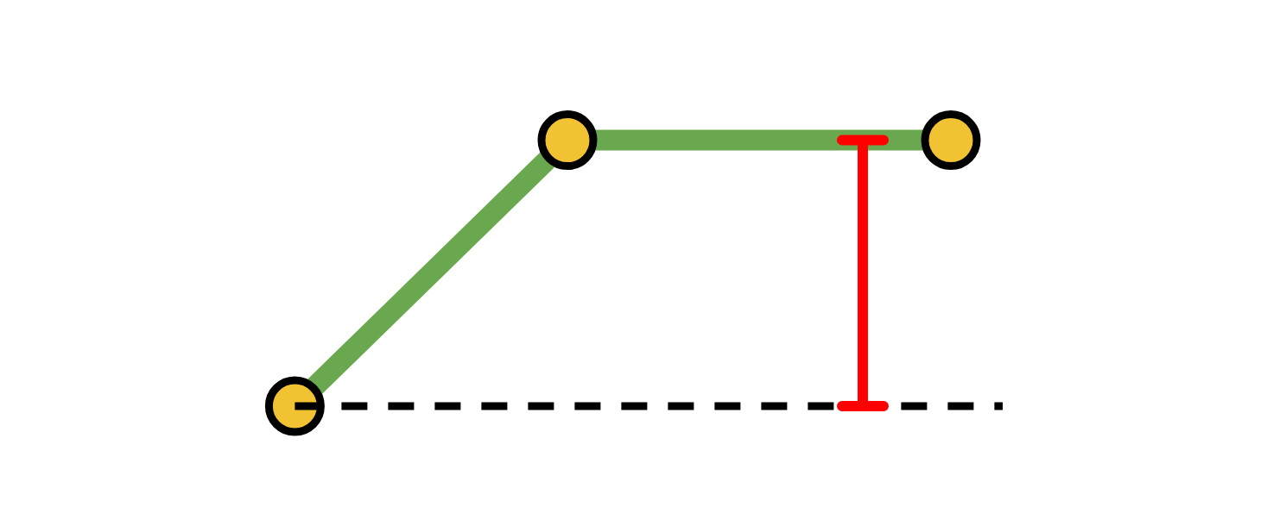
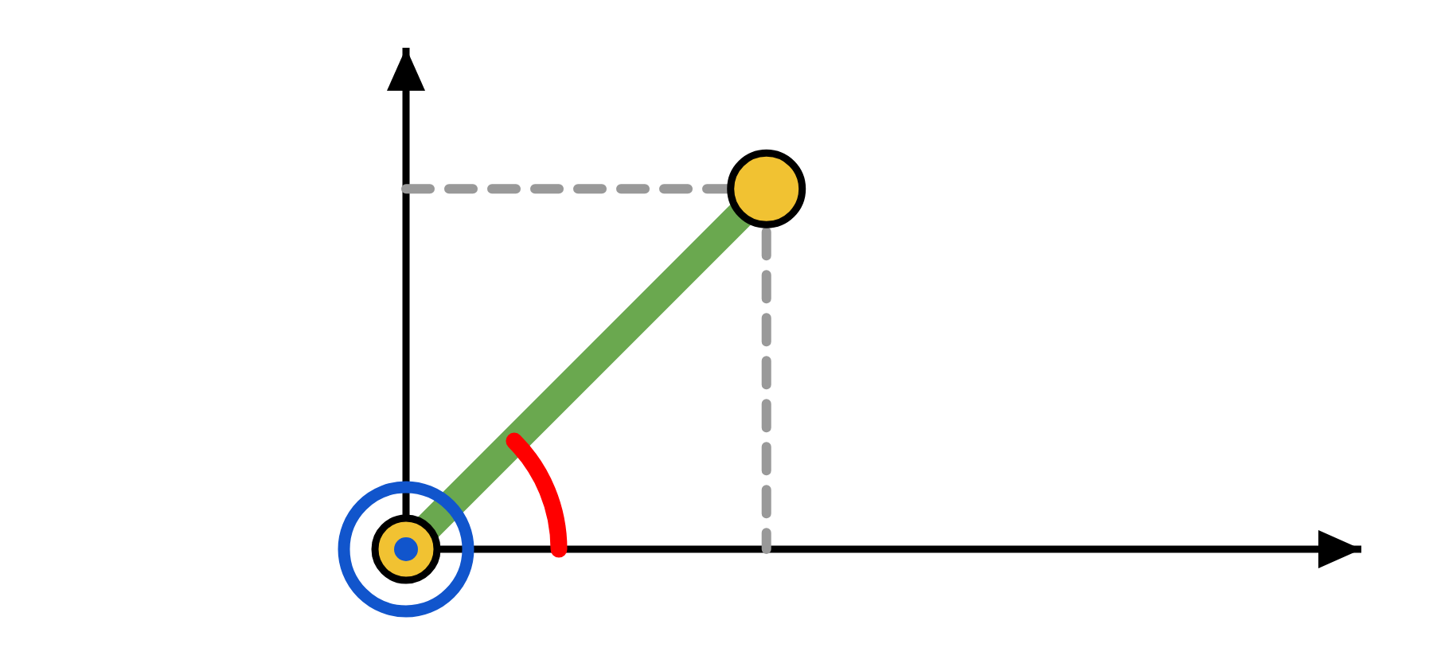
Step 2: Multiply A₁ · (A₂ · A₃)
DAY 2 · WORKED EXAMPLE
z = 176.78
Now add the base turn. The last column is the answer.
0.7071
0
0.7071
0
1
0
0
426.78
0.7071
0
0.7071
301.78
0.7071
0
−0.7071
0
×
0
1
0
176.78
=
0.7071
0
−0.7071
301.78
0
1
0
0
0
0
1
0
0
1
0
176.78
0
0
0
1
0
0
0
1
0
0
0
1
A₁
A₂ · A₃
T = A₁ · A₂ · A₃
TOP VIEW
THE TIP POSITION
y
(x, y, z) = (301.78, 301.78, 176.78) mm
y = 301.78
Day 1 gave a reach of 426.78 mm. The base turn of 45° splits it: 426.78 × cos 45° = 301.78 for x, and 426.78 × sin 45° = 301.78 for y. The height z = 176.78 does not change.
426.78
x
x = 301.78

Slide 32
Same Answer as Lesson 3
DAY 2 · CHECK
z = 176.78
LESSON 3 · TRIGONOMETRY
LESSON 4 · DH MATRICES
Triangles give a reach R and a height h.
The last column of T = A₁ · A₂ · A₃.
X
= 301.78
x
= 301.78
=
Y
= 176.78
y
= 301.78
up
Z
= 301.78
z
= 176.78
up
SAME NUMBERS, DIFFERENT LETTERS
WHY THEY MATCH
Lesson 3 put up on Y. Lesson 4 puts up on z. So Lesson 3's Y is z here, and its Z is y.
Both methods describe the same arm in the same pose, so they land on the same point.

Slide 33
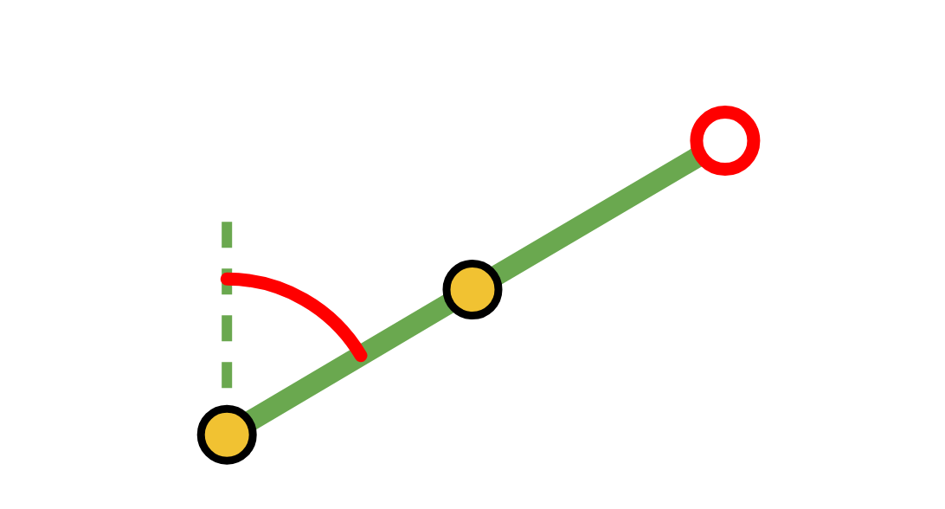
Try It Yourself #4
θS = 60°
DAY 2 · TRY IT YOURSELF
θE = 0°
Find the tip position (x, y, z).
Joint
θ
d
a
α
L₁ = L₂ = 250 mm
1 · Base
?
0
0
90°
θB = 30°
θS = 60°
θE = 0°
2 · Shoulder
?
0
250
0°
(x, y, z) = (?, ?, ?)
3 · Elbow
?
0
250
0°
SOLUTION
TIP POSITION (x, y, z) IN MM
θ column: 30°, 90° − 60° = 30°, 0°
(375.00, 216.51, 250.00)
θ = 90° − θS for the shoulder and θ = −θE for the elbow.
The same arm shape as Try It Yourself #3, with the base turned 30°.

Slide 34
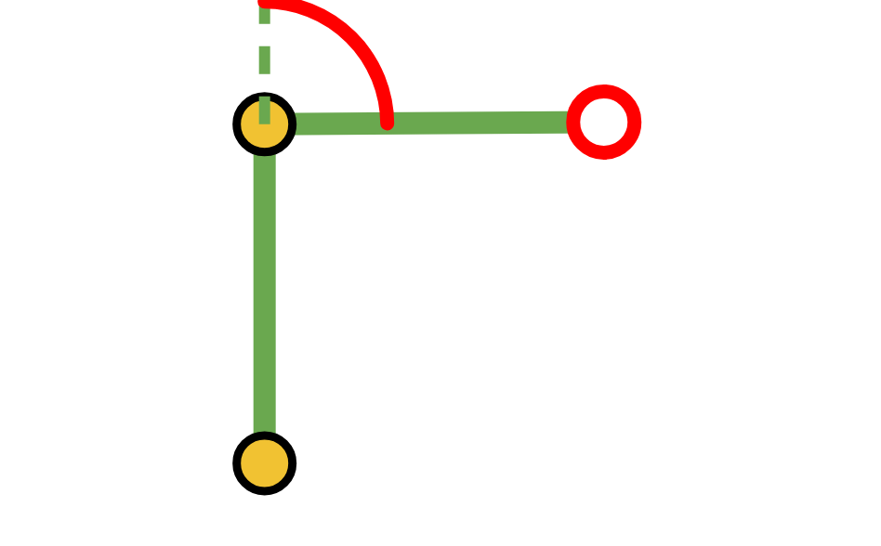
Try It Yourself #5
θE = 90°
DAY 2 · TRY IT YOURSELF
θS = 0°
Find the tip position (x, y, z).
Joint
θ
d
a
α
L₁ = L₂ = 250 mm
1 · Base
?
0
0
90°
θB = 120°
θS = 0°
θE = 90°
2 · Shoulder
?
0
250
0°
(x, y, z) = (?, ?, ?)
3 · Elbow
?
0
250
0°
SOLUTION
TIP POSITION (x, y, z) IN MM
θ column: 120°, 90° − 0° = 90°, −90°
(−125.00, 216.51, 250.00)
θB = 120° turns the arm past the y axis, so x is negative.
z = 250: the upper arm stands straight up and the forearm lies flat.

Slide 35
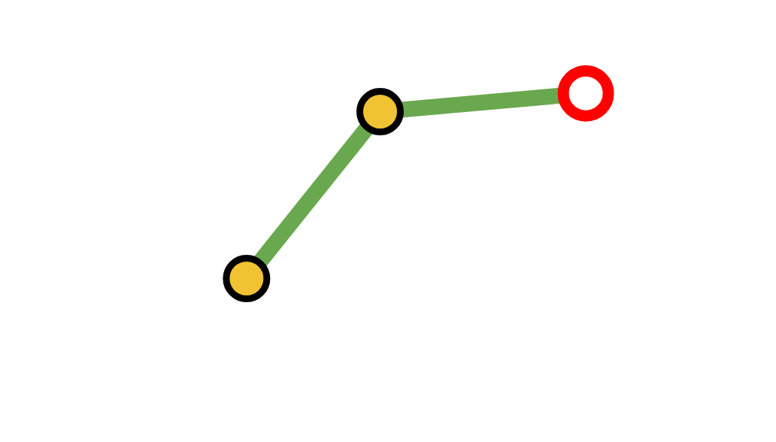
Check It with Code
(x, y, z)
DAY 2 · CHECK WITH CODE
PYTHON
OUTPUT
from dh_helper import dh_matrix, position
[301.78, 301.78, 176.78]
thetaB, thetaS, thetaE = 45, 45, 45
The same as the hand calculation.
A1 = dh_matrix(thetaB, 0, 0, 90)
A2 = dh_matrix(90 - thetaS, 0, 250, 0)
CHECK YOUR ANSWERS
A3 = dh_matrix(-thetaE, 0, 250, 0)
Change the three angles in line 2 to the values from Try It Yourself #4 and #5.
T = A1 @ A2 @ A3
print(position(T))
WHAT EACH PART DOES
dh_matrix builds one matrix from one row of the table. @ multiplies matrices. position reads the last column.

Slide 36
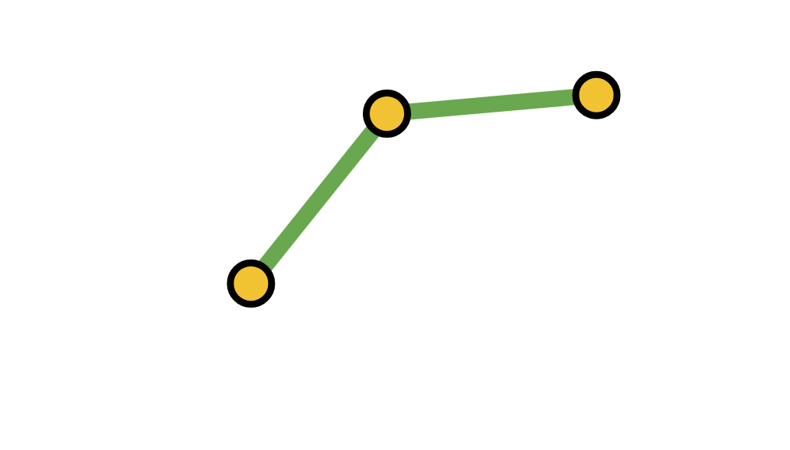
Trigonometry vs. DH Matrices
DAY 2 · COMPARISON
LESSON 3 · TRIGONOMETRY
LESSON 4 · DH MATRICES
+
Quick for one or two joints
+
The same recipe for every joint
+
Easy to picture with triangles
+
A computer can do the multiplying
−
New triangles for every new joint
+
A standard way to describe robot arms
−
Gets messy when the arm tilts in 3D
−
More setup: frames and a table
Both methods give the same answer. DH keeps working as the arm gets bigger.

Slide 37
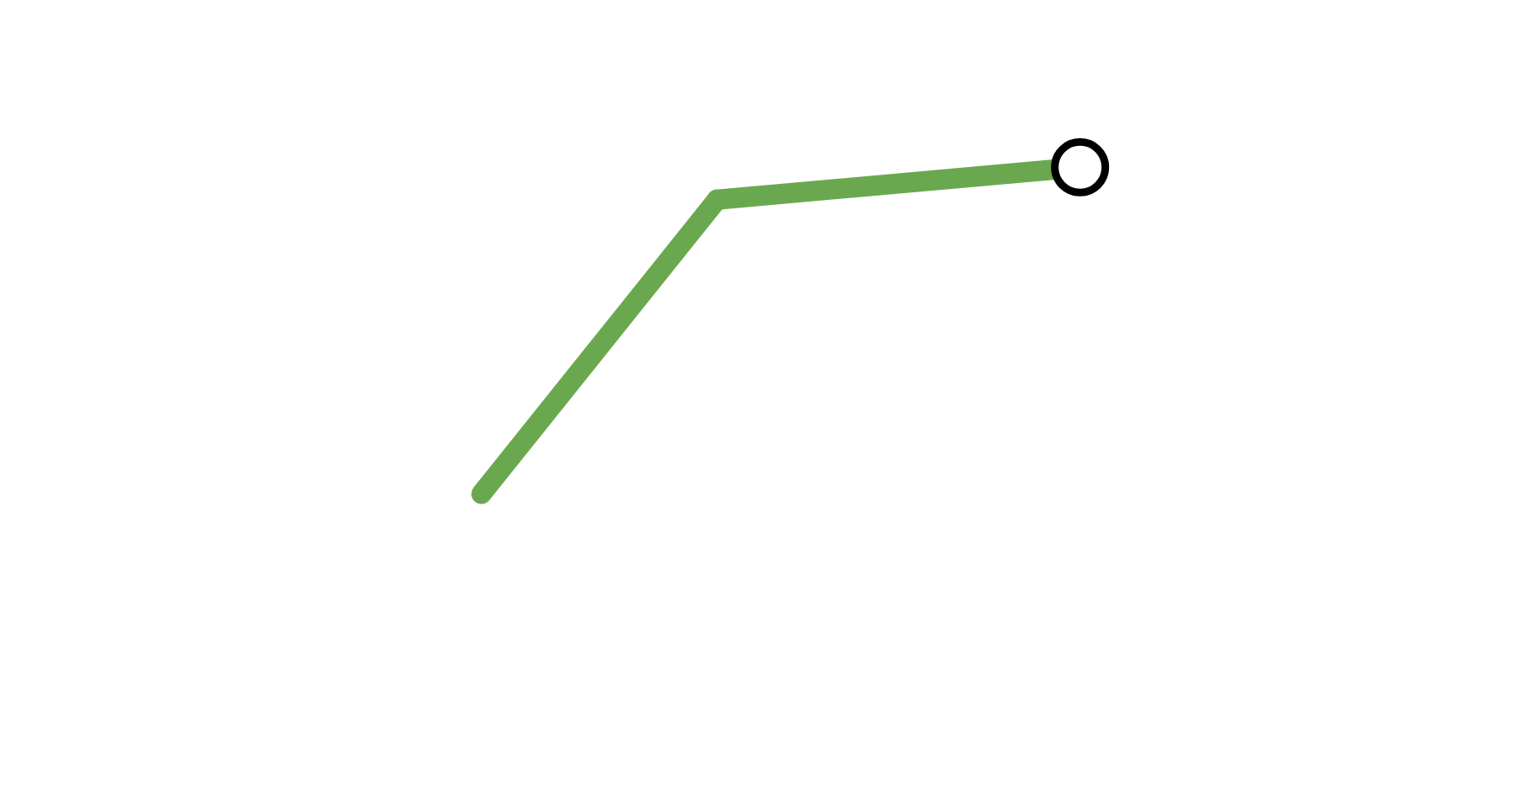
What We Learned
DAY 2 · WRAP-UP
Every joint becomes one matrix, built from four numbers: θ, d, a, α.
NEXT TIME · LESSON 5
1
Code Implementation of FK & Other Methods
2
Frames: z is the joint axis, x is the link.
We turn forward kinematics into code, then take a short look at screw theory, another way to describe the same arm.
3
Multiply the matrices in joint order: T = A₁ · A₂ · A₃.
T
4
The last column of T is the tip position (x, y, z).
3
2
1

